Slide 1

Reset your life:
E-mental health support for people with gambling addiction
Tony Clarkson, Principal Clinical Advisor, Victorian Responsible Gambling Foundation, Reframing Addiction Conference
Tasmania Nov, 2022

Slide 2
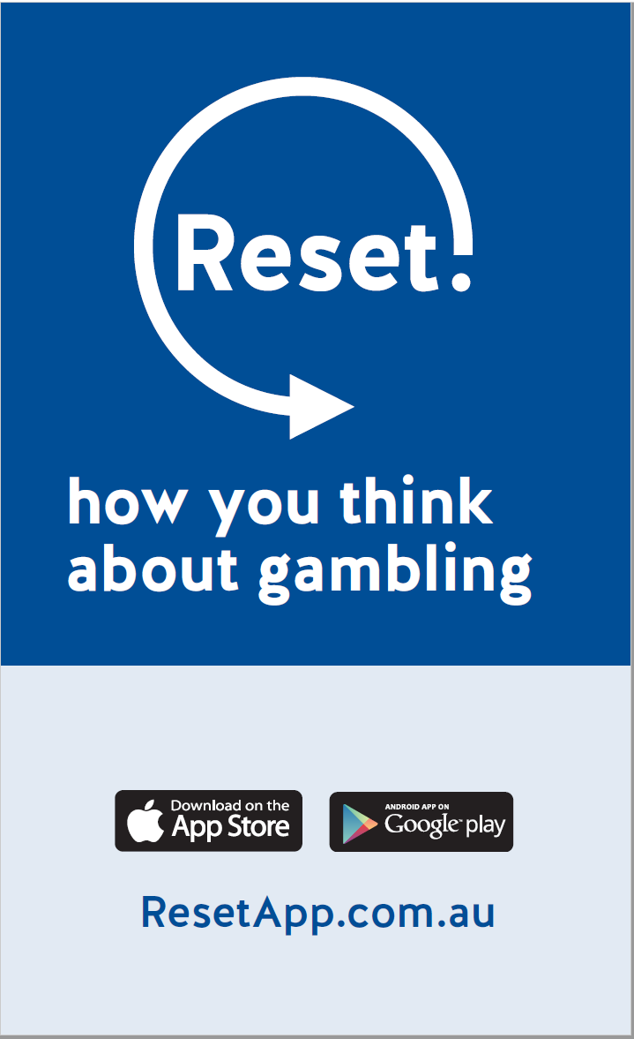
What is Reset?
mobile and web-based app
self-directed self-help tool
based on latest clinical research
free and confidential
support in your pocket, available anywhere, 24/7.

Slide 3

What is RESET?

Slide 4
Where it all started
What is GamblingLess?
designed to help people with gambling problems
developed by Australian researchers
based on research funded by VRGF
8-week program, web-based and self-directed
based on cognitive–behavioural therapy and motivational interviewing
four modules, each with 13-15 activities.

Slide 5
Why build an app?
Advantages of self-directed, self-help apps include:
  shown to be effective for other disorders such as depression and anxiety
  typically shorter and more cost effective than face-to-face therapies
  provide treatment in the moment, when needed
  reach more people
  less intimidating and stigmatising than traditional in-person services
  allows people to engage in treatment at their own pace, anywhere, anytime.

Slide 6
How the app was built
Funding, project scope, etc
App development challenges
Beta testing and stakeholder engagement
Endless patience

Slide 7
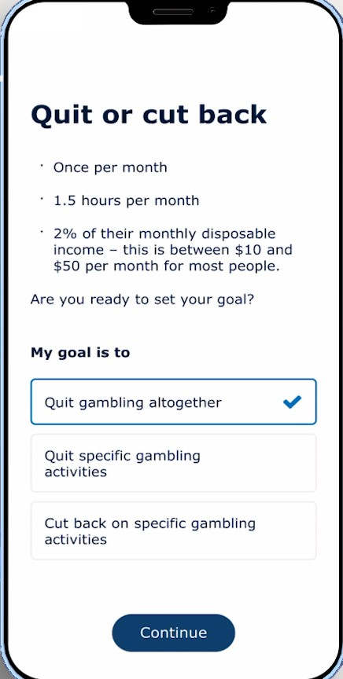
How does Reset work?
Reset helps users:
learn to understand their triggers and why they gamble
develop strategies to help cut back or quit gambling
manage urges and stay on track with practical techniques and advice
maintain change through managing high risk situations and learning from lapses
record and track progress, and
access other support services

Slide 8
How does Reset change the way you think about gambling?
  Cognitive behavioural therapy and motivational interviewing
  Reflection is 9/10 of the effect
  MI – identify benefits of change
  MI – set goals, identify strategies/strengths
  CBT – link thoughts with actions
  Relapse acceptance

Slide 9
The Reset program
Reset consists of six modules:
Onboarding & getting started
Getting ready
Taking control
Taking action
Managing urges
Maintaining change
Each module contains activities, videos, information and practical advice.
Users can choose any module or activity they like or follow the program of recommended activities.

Slide 10

Example:
Module 4 – Managing urges

Slide 11
How will Reset evolve?
Following an evaluation of the app, the Reset team will explore options for:
  improving the app
  providing Reset in languages other than English
  tailoring the app for First Nations or other priority communities.

Slide 12
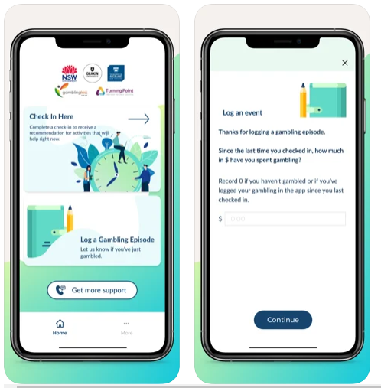
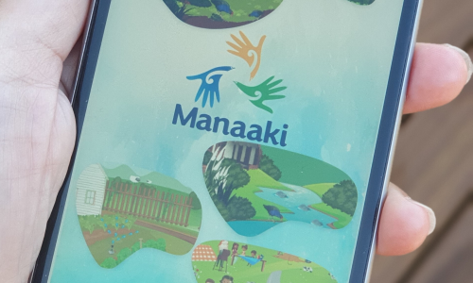
How does Reset differ from other GamblingLess-based apps?
‘Gambling Habit Tracker’ and ‘GamblingLess: In the moment’ NSW
‘Manaaki’
New Zealand

Slide 13
Evaluation
Who will evaluate Reset
  Researchers from Deakin University
When?
  Six weeks after opted-in users first begin using the app
How?
  Reset users opt in to be contacted by researchers to take part in the evaluation
  Not compulsory, privacy and confidentiality ensured
  Participants compensated with e-vouchers
What we hope to get out of the evaluation
  measure effectiveness of Reset
  ways to improve the app

Slide 14
Marketing and strategic Communication of Reset
Launch event TBC
Organic social channels
Microsite
Digital campaign
In-venue posters and promotion

Slide 15
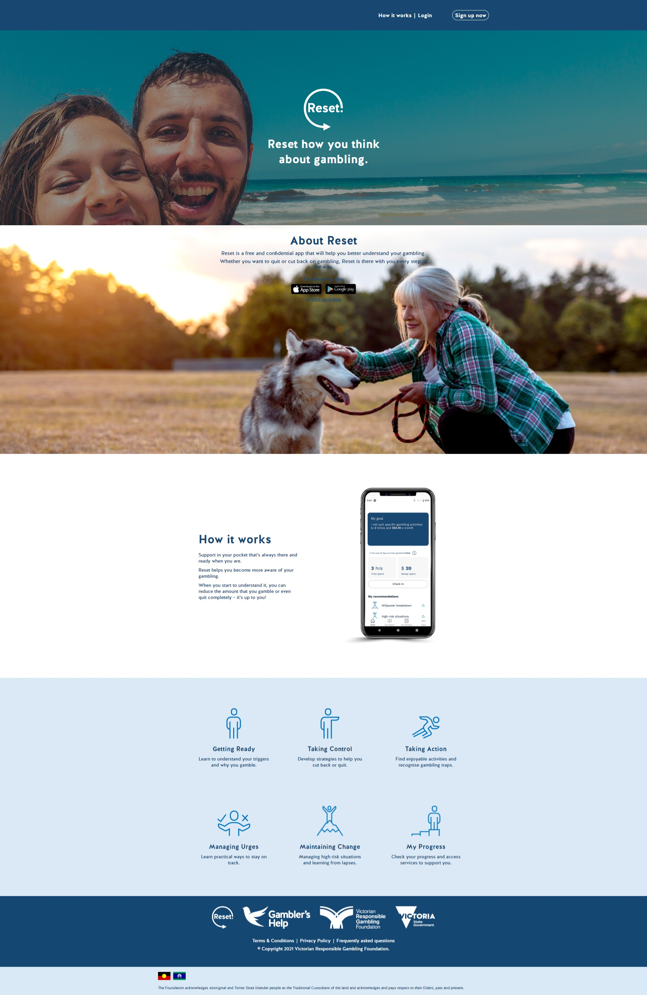
Marketing: microsite
ResetApp.com.au

Slide 16


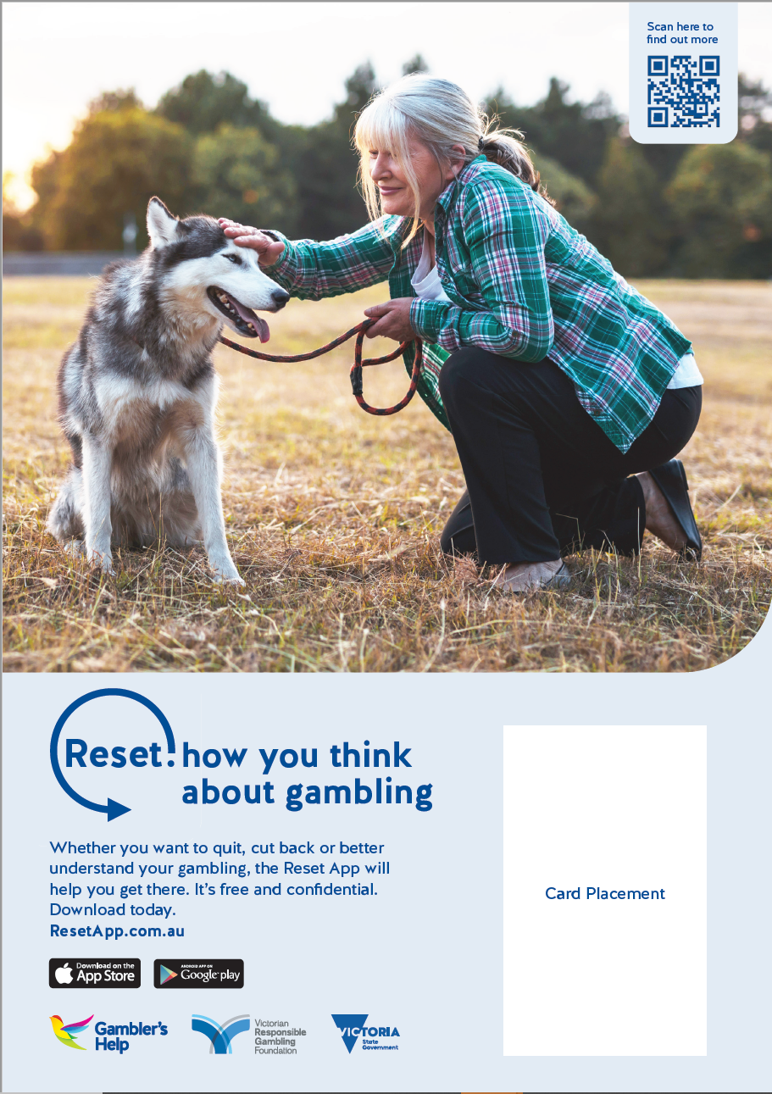
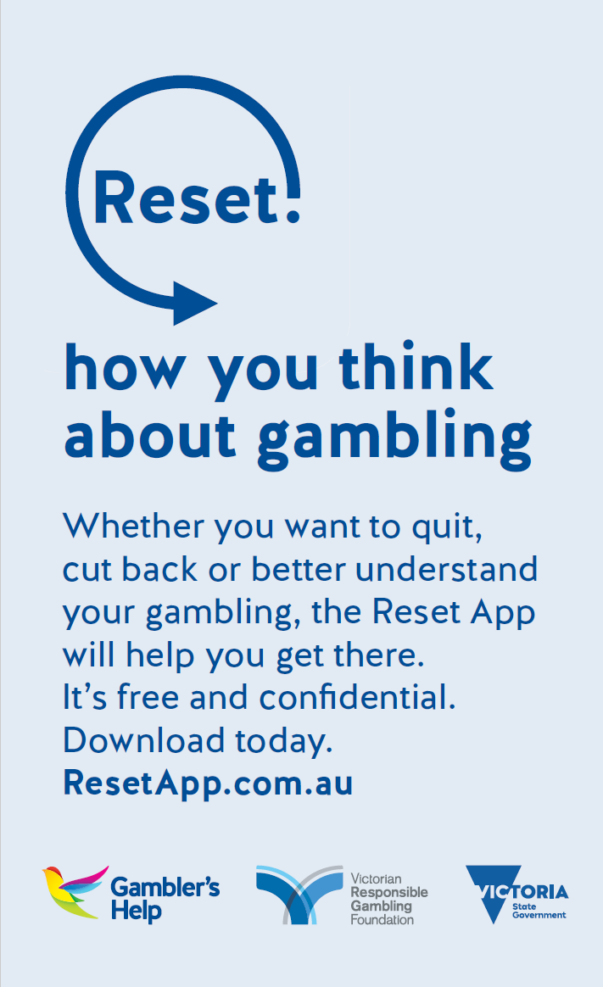
Marketing: In-venue
In-venue posters
Wallet cards

Slide 17

Contact
Tony Clarkson
Principal Clinical Advisor
Victorian Responsible Gambling Foundation, Level 6, 14-20 Blackwood Street, North Melbourne, 2052
www.responsiblegambling.vic.gov.au
www.gamblershelp.org.au
tony.clarkson@responsiblegambling.vic.gov.au `

