Slide 1
Gambling Addiction – Service Integration & Screening
Tony Clarkson, Principal Clinical Advisor, Victorian Responsible Gambling Foundation, Reframing Addiction Conference
Tasmania Nov, 2022

Slide 2
Menu
Gambling and addiction – the facts
Gambling and comorbidity
Gambling and covid
Victoria’s Royal Commission
Systems: gambling and mental health
Systems: gambling and AOD
What next?

Slide 3
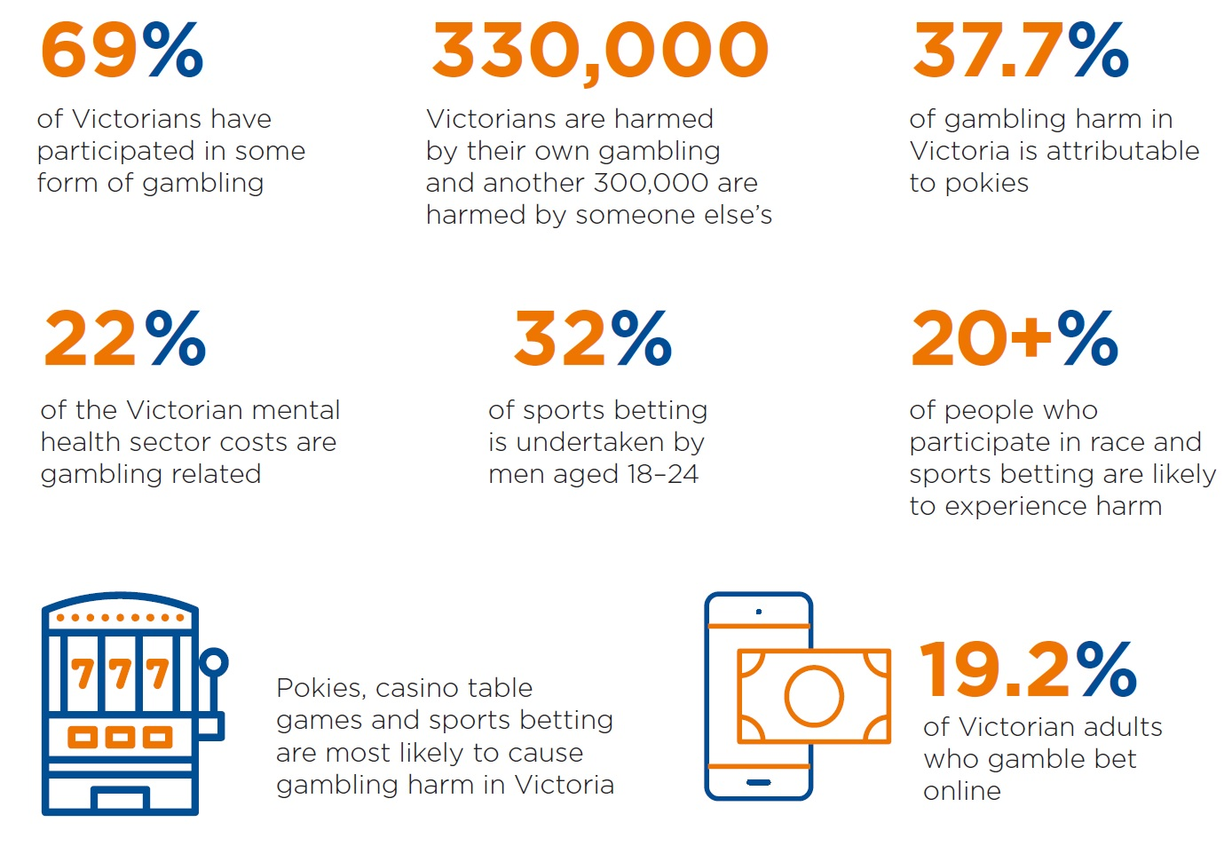
Gambling & addiction – the facts

Slide 4
Gambling & addiction – the facts

Slide 5
Gambling addiction and mental health

Slide 6
Gambling addiction and mental health

Slide 7
Mental health comorbidity where gambling frequently occurs (clinician rated)

Slide 8
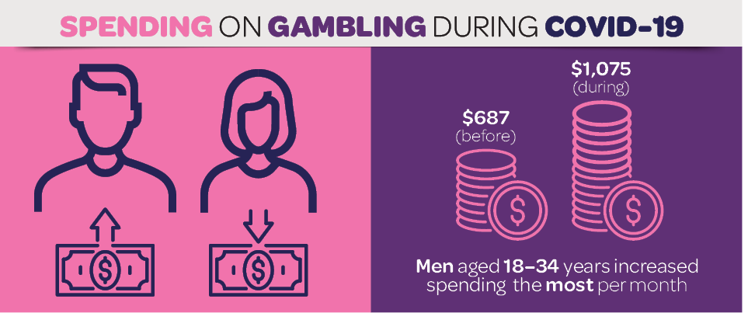
Gambling & Covid
Australian Institute of Family Studies, Gambling in Australia During Covid-19, October 2020

Slide 9
Gambling & Covid
When asked what impact COVID-19 had had on their health, around half reported that their physical health (50%) and mental health (56%) had been negatively affected.
Some key experts reported improvements in the health and wellbeing of some of their clients who had reduced or 'taken a break' from gambling, but most were concerned about the negative impacts that COVID-19 and the related restrictions were having on people's mental health, and the potential for ongoing and legacy health harms that some people may experience.
Australian Institute of Family Studies, Gambling in Australia During Covid-19, October 2020

Slide 10
Final report tabled in parliament on 3rd February, 2021
9 recommendations from interim report; 65 from final
Focus on system redesign, early intervention, LEX involvement, care in the community, patient choice, youth
60 Locals – better access, multidisciplinary care
22 Area Mental Health & Wellbeing services – public health/hospital partnerships, psychosocial support
8 ‘regions’, below

Slide 11
Recap – 22% and $1.6B costs
GH MIA – not recognised as a public health issue; under recognised as a mental health issue; missing from public health, mental health and suicide prevention plans; missing from RC’s TOR
Undermines treatment uptake/confidence
Increases stigma

Slide 12
The Royal Commission & Gambling
3195 pages – 8 mentions of gambling
35: Improving outcomes for people living with mental illness and substance use or addiction – by Dec 2022
36: A new state-wide service for people living with mental illness and substance use or addiction
1 (interim): Collaborative Centre for Mental Health & Wellbeing

Slide 13
The role of gambling treatment in the broader mental health system
Comorbidity
Screening/assessment/referral
Shared models of care
Multidisciplinary responses
Sector development
Complex care

Slide 14
What next?
Cross government response
Allied health pilots
AMA, RACGP and primary care
Mindframe
Reset
Stigma reduction, behaviour change

Slide 17
Contact
Tony Clarkson
Principal Clinical Advisor
Victorian Responsible Gambling Foundation, Level 6, 14-20 Blackwood Street, North Melbourne, 2052
www.responsiblegambling.vic.gov.au
www.gamblershelp.org.au
tony.clarkson@responsiblegambling.vic.gov.au `

