Slide 1
Psychonauts
In Space
Nancy Thomas – Senior AOD Clinician

Slide 2
Introduction
YFCC – Youth Family and Community Connections Inc.
Not for profit organisation, serving the North West Coast
Youth employment
Crisis accommodation support services and transitional accommodation programs
Family support services
AOD programs:
Youth AOD programs in Burnie and Devonport
All ages programs in Devonport – Burnie – West Coast – Circular Head – King Island

Slide 3
Psychedelics: a hot topic
The term psychonaut means “a person who uses altered states for such exploration”.
Albert Hoffman:
chemist
Sacha Shulgin: chemist
Ann Shulgin: clinical psychologist
Terence Mckenna: ethnobotanist & ecologist
Dennis Mckenna: botanist
Psychonauts in Space – Nancy Thomas. YFCC. 23/11/22

Slide 4
What we know about psychedelics
Psychedelics change and enhance sensory perceptions, thought process and energy levels. They alter neural pathways which open the brain’s architecture allowing the user to process, transmute and transform information via accessing a higher state of conscious awareness of themselves, situations past, present and environment.
Psychedelics such as;
psilocybin (magic mushrooms)
ayahuasca
mescaline (cactus such as peyote and San Pedro)
bufo toad secretions (5-meo-DMT)
opium
cannabis
coca leaf
iboga

Slide 5
What we know about psychedelics
Have been consumed by humans for 9000+ years!!!
Used for (-’s)
Used for (+’s)
Part of cultural tradition
Medicinal healing
Spiritual awakening and enlightenment
Woodstock
Creativity
Experiments
War time
Psychiatric
Social

Slide 6
How do psychedelics treat addiction and trauma?
WHAT WE KNOW NOW IS…
Trauma and addiction are emotional disorders
Complex emotional states are hard to treat using conventional CBT
Emotional states include; shame, guilt, disgust, self loathing, hatred, acceptance, negative beliefs
MDMA/ Psilocybin – facilitate the resolution of complex emotional states without the discomfort of distress or Vagal dysregulation
People can access self love and acceptance, can rationalise, reprocess, apply advanced empathy
It is well founded that the named emotional states are what are underly addiction/lapse/relapse and ongoing trauma symptomology.

Slide 7
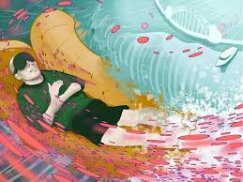
Mind Medicine Australia
WHAT HAVE THEY BEEN UP TO?

Slide 8
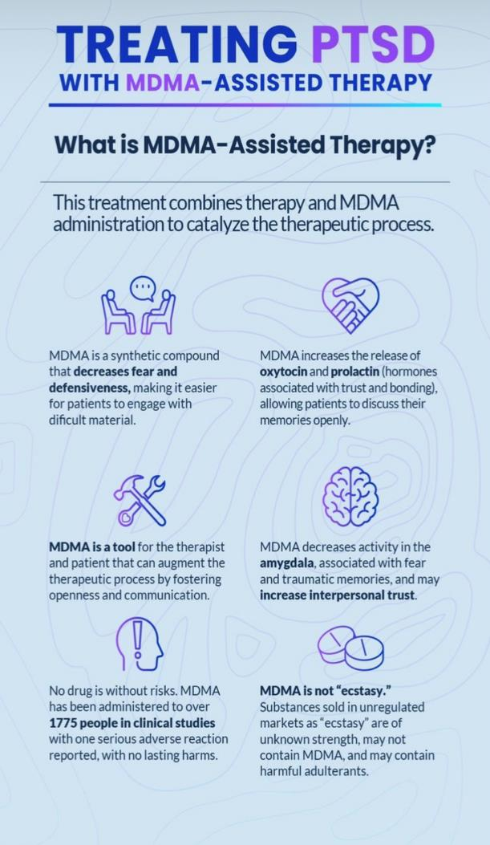
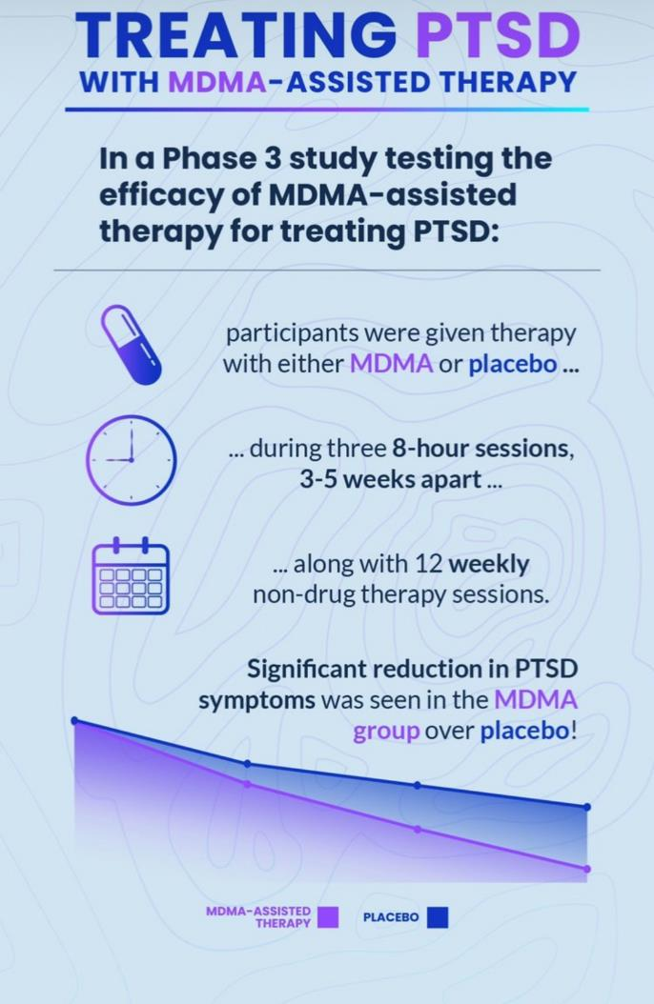
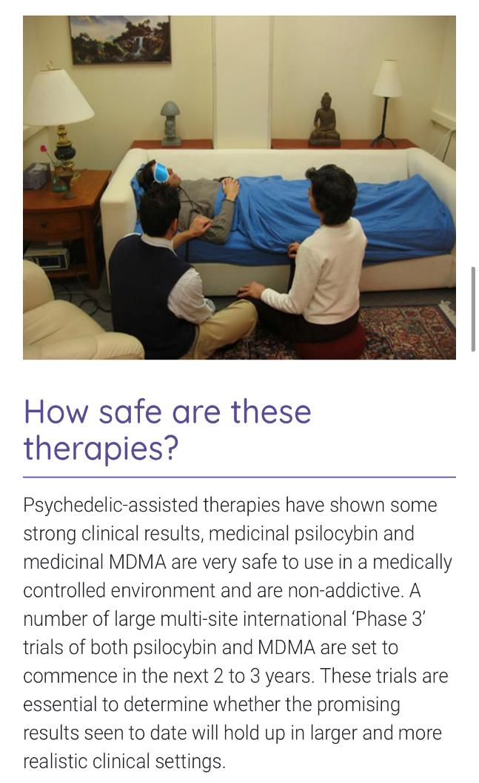
Psychonauts in Space – Nancy Thomas. YFCC. 23/11/22

Slide 9
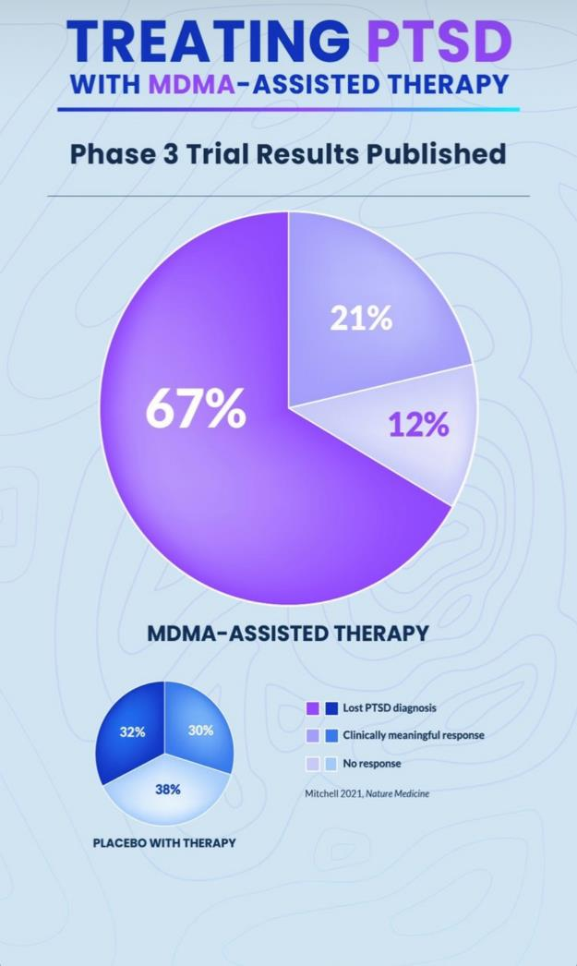
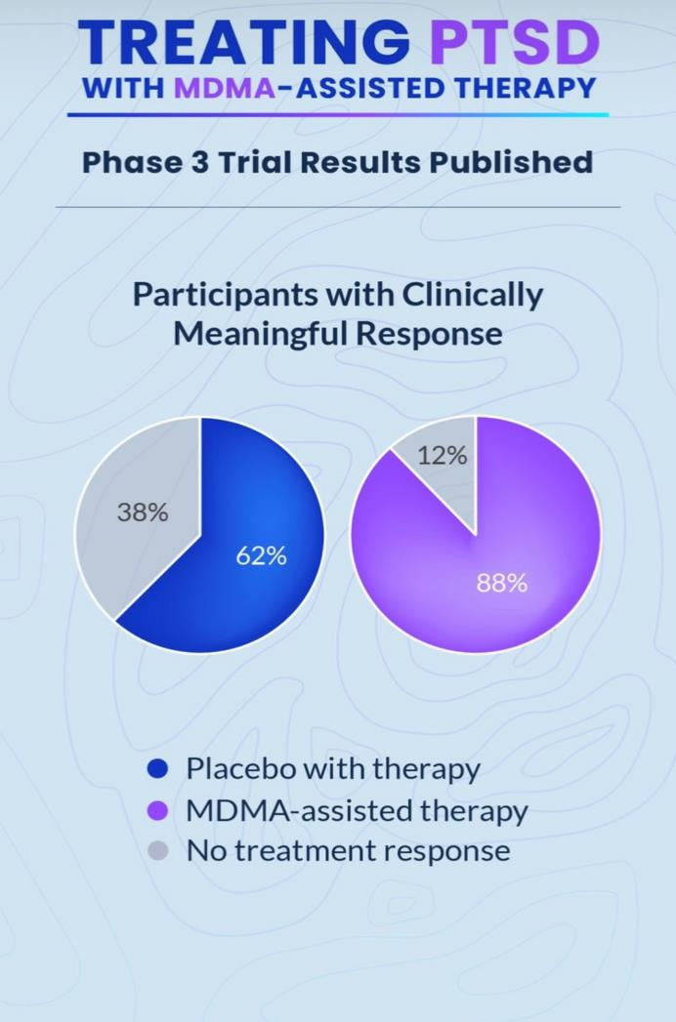

Slide 10
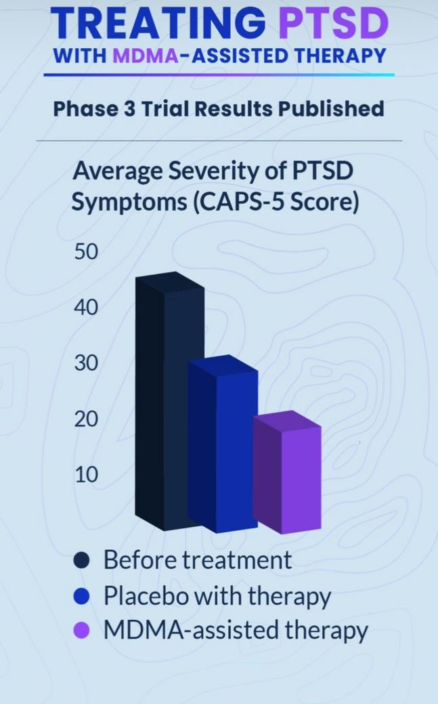
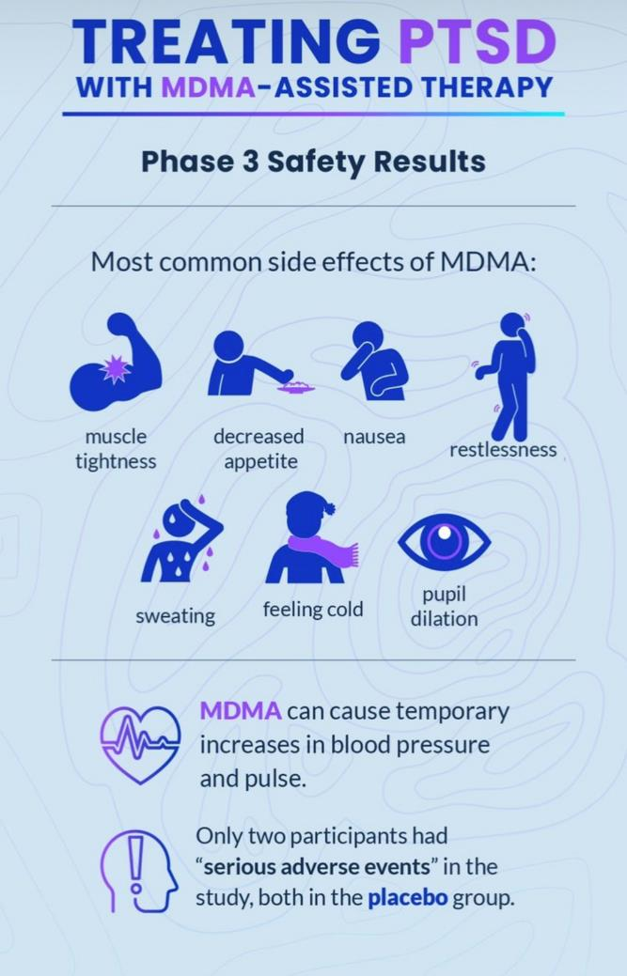
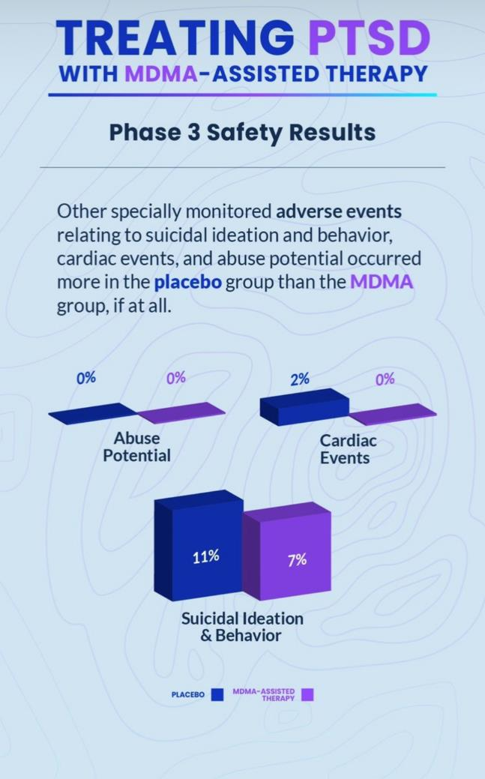

Slide 11
The legal stuff...
Access to psychedelic psychotherapy is not available in Australia…. yet!
numerous submissions past and present;
TGA
State – federal commissions
Legislative change
Psychonauts in Space – Nancy Thomas. YFCC. 23/11/22

Slide 12
What next?
Continue training practitioners
Submissions;
TGA – scheduling and access
STATE – FEDERAL legislation
The science is there … it’s just ….

Slide 13
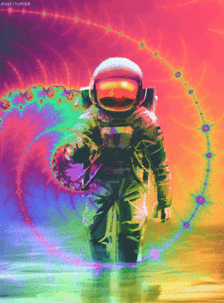
So begs the question…
Will we see this therapeutic approach in our lifetime?
Answer… Absolutely we will!!

Slide 14
Break out groups
Scenario…
A Client presents to your service. They are 21 YO, have been smoking cannabis daily since 15 YO. They have disclosed significant family violence while growing up. They have been diagnosed with depression and anxiety and are medicated with SSRI’s. They have seen media around using psychedelics therapeutically and have been considering taking Psilocybin (Magic mushrooms). They are aware the grow wild in Tasmania during the colder time of the year.
Psychonauts in Space – Nancy Thomas. YFCC. 23/11/22

Slide 15
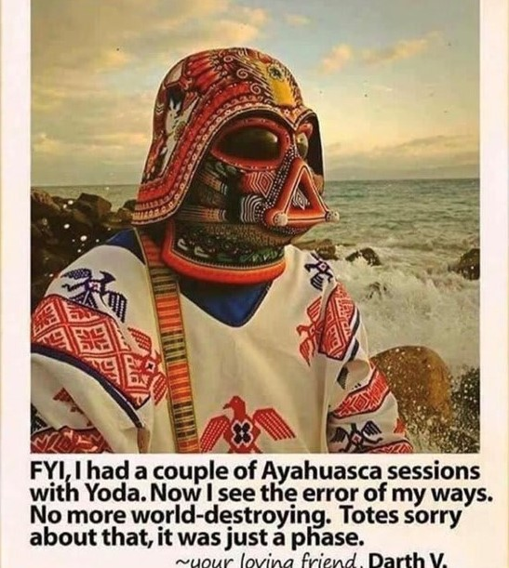
Thank you
Nancy Thomas – Senior AOD Clinician
YFCC
64 Stewart Street, Devonport, TAS. 7310
0409 197 847
nancy@yfcc.com.au
www.yfcc.com.au

