Slide 1
Addictions in the broad sense Development, emotion and addiction
Dr eli kotler
Medical director
Adjunct lecturer
Consultant psychiatrist

Slide 2
outline
Human Nature
Addictions
Treatment
To understand addiction we need to understand emotional pain, to understand emotional pain we need to understand emotion, and to understand emotion we need to understand human nature.

Slide 3
Human nature

Slide 4
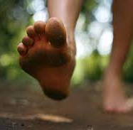
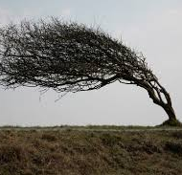
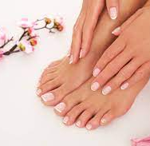

Slide 5
What do contemporary models of the mind/human nature say about compulsive and impulsive behaviours?
Psychoanalytic theory
Philosophy (of Mind)
Free-Energy Principle
Affective Neuroscience

Slide 6
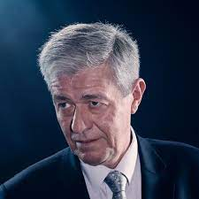
Free energy – guiding principle of all life
Karl Friston
Revolutionsed brain mapping/imaging
Originator of the Free Energy Principle
Most influential neuroscientist alive

Slide 7
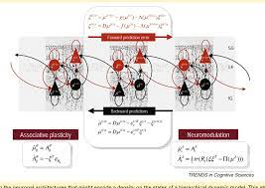
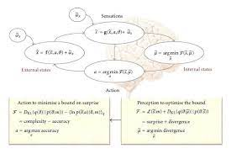
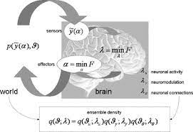
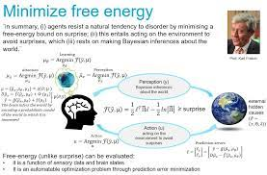
Computational neuroscience
We don’t have to understand the maths (though would be nice to!)
We can understand the concepts of how the brain-mind functions

Slide 8
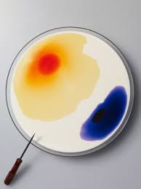
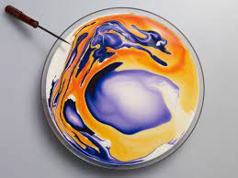
Increased entropy

Slide 9
Decreased entropy/FE
If you saw this occur, you may think that the ink is ‘alive’

Slide 10
Free energy
Life follows one rule – to decrease entropy (Free Energy)
To remain in a few specific states rather than randomness
To do this, we share a minimum structure and function
Structure
Sensory – sense the environment/other
Internal models of the external world
Motor – impact the environment/other
Function
To decrease Free-Energy
Prediction error = Surprise = Entropy
Motor: to automatically decrease entropy/prediction error

Slide 12
Generative/predictive Internal working models
Internal models, model the parts of the world which are important for survival (NEEDS)
Generate models of the world based on what has kept me alive in the past (e.g. temp < 0)
Compares model of the world with incoming sensory information
The difference = prediction error = surprise = FE
The system will work to decrease PE/FE by either
Updating the internal working model of the world to fit with sensory data (learning)
Altering the world, through the motor system, until the world fits with the internal model (repetition-compulsion); Until I see what I expect to see, based on my past experience
The motor systems will automatically (compulsively/impulsively) work to decrease PE/surprise/FE
Occurs almost instantaneously and unconsciously

Slide 13
Human nature
Humans are driven to survive, motivated by survival
Humans have needs which must be met, founded on homeostatic mechanisms, to keep us within limits
Free-Energy;
Formalises the function and structure by which we survive, by decreasing entropy
Organisms have a minimal
Function; decrease FE/entropy/surprise/prediction error
Structure; sensation, internal working model of external world, motor
Compulsive behaviours are learnt motor programs triggered by a perceived threat/need to survive, based in past experiences
Affective Neuroscience
Human needs are represented by sub-cortical circuits which are connected to feelings
Needs not met = aversive feeling
Needs met = rewarding feeling
FE + AN = we will compulsively do what makes us feel better, or not feel worse (to escape pain)
Psychoanalytic developmental theory
Our personalities are shaped by conflict, by intensity of unresolved emotional pain

Slide 14
What do contemporary models of the mind/human nature say about compulsive and impulsive behaviours?
Psychoanalytic theory
Philosophy (of Mind)
Free-Energy Principle
Affective Neuroscience

Slide 15
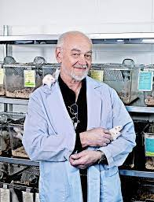
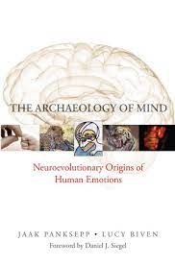
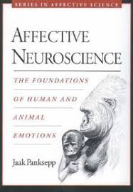
Affective neuroscience – the biological underpinnings of human life
Jaak Panksepp (RIP 2017)
Devoted his life to pre-clinical science of the neural mechanisms of emotions
Critical of the behavioural and cognitive approaches of main-stream neuroscience
Inspired Temple Grandin

Slide 16
What are feelings?
How do you know
That your body needs more water
That your body needs to go to the toilet
That the environment is becoming too cold

Slide 17
Feelings
3 aspects;
Valence
Quality
Intensity

Slide 18
Needs that our feelings tell us about
Encoded in sub-cortical neural circuitry
Biological
Sensory
Social/Mammalian

Slide 19
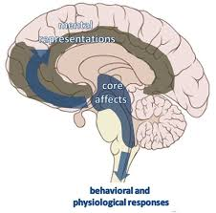
Social/emotional needs
Internal working models include emotional/survival/need circuits in the brainstem/limbic regions
This is why the internal models are related to core emotions
Object-relations/Internal objects
Jung’s complexes
The social/mammalian Survival/Need/Emotional circuits
SEEKING (dopamine)
FEAR
ANGER
LUST
PLAY
CARE
ATTACHMENT (opiates)

Slide 20
Why do we have intense negative feelings? “Ancestral voices”
Biologically and psychologically
Let us know that a need must be met right now
Let us know which need must be met
Push us to act, due to the negative valence of the feeling
“…an instinct appears to us as a concept on the frontier between the mental and the somatic, as the psychical representative of the stimuli originating from within the organism and reaching the mind, as a measure of the demand made upon the mind for work in consequence of its connection with the body.”
Freud, Instincts And Their Vicissitudes, 1915 pp. 121-122

Slide 21
Human nature
Humans are driven to survive, motivated by survival
Humans have needs which must be met
Free-Energy;
Formalises the function and structure by which we survive, by decreasing entropy
Organisms have a minimal
Function; decrease FE/entropy/surprise/prediction error
Structure; sensation, internal working model of external world, motor
Compulsive behaviours are learnt motor programs triggered by a perceived threat/need to survive, based in past experiences
Affective Neuroscience
Human needs are represented by sub-cortical circuits which are connected to feelings
Needs not met = aversive feeling, Needs met = rewarding feeling
FE + AN = we will compulsively do what makes us feel better, or not feel worse (to escape pain) = perceived survival (learnt)
Psychoanalytic developmental theory
Our personalities are shaped by conflict, by intensity of unresolved emotional pain, leading to compulsive traits

Slide 22
What do contemporary models of the mind/human nature say about compulsive and impulsive behaviours?
Psychoanalytic theory
Philosophy (of Mind)
Free-Energy Principle
Affective Neuroscience

Slide 23
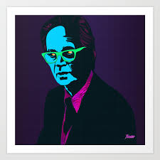
Emotions and learning/development
Feelings guide learning/development
Conditioning in animals/humans likely based in feeling states
Skinner
“A behavioural account has two unavoidable gaps – between stimulus and response, and between reinforcement and a resulting change in behaviour.”
Panksepp
“…no, Skinner would never have accepted that rats have feelings. I gave him a chance, but he blew me off”

Slide 24
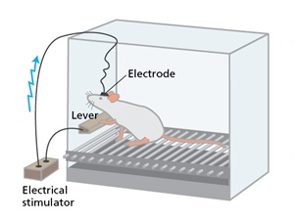
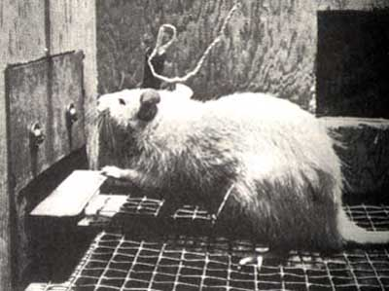
conditioning
What happens “between stimulus and response”?
What is the “gap”?
Panksepp suggested FEELINGS
FEELINGS guide learning/development
We are not hedonistic per se, rather our system is such that acts which increase survival feel good, they are ‘rewarding’, and acts which decrease survival feel bad, so we avoid them

Slide 25
development/learning
“Memory… is a useful tool for anticipating and dealing with future events… by anticipating survival issues, intrinsic affective states provide immediate guidance of behaviour. These feelings are connected to world events through learning… Thus, through the blending of our instinctual emotional abilities and associated memories of external life events, we begin to experience many neutral aspects of the world affectively”.
“…the unconditioned emotional responses to environmental events are the felt ‘rewards’ and ‘punishments’ within the brain.”
“Emotional learning involves the acquisition of an emotional response to a previously neutral experience. Emotional memory is the retention of their response over time.”
“…acquisition of new responses is automatic and involuntary – and all the essential circuitry is situated below the neocortex.”
Hence, learning is often “neither conscious nor cognitive”.
Panksepp

Slide 26
Development when needs are met
Lots of positive emotional experiences
Learn healthy patterns to get my needs met

Slide 27
Development when needs not met
Childhood full of difficult feelings and conflict
Learn to meet needs in a compromised way/conflictual way
ATTACHMENT versus FEAR/ANGER
Two general possible outcomes (splitting) – by altering internal working models/predictions
FEAR/ANGER will be ‘sacrificed’ to ATTACHMENT (leads to compulsive idealization of care-giver, and fear, anger will be repressed and distorted toward self and others as projections)
ATTACHMENT will be ‘sacrificed’ to FEAR/ANGER (leads to compulsive ‘independence’ and repressed loneliness, rejection etc.)
Personality becomes shaped by unmet needs (unresolved painful feelings) and the compulsive avoidance strategies (which rids us of the difficult feelings by altering our reality – if I don’t feel it, it doesn’t exist)
These unresolved painful feelings, and the structures created to defend against them are the basis for personality development (psychoanalytic developmental theory).
‘Pathology’ is seen in patterns of thoughts, feelings and behaviours, fueled by intolerable feelings (unmet needs), rather than categorical diagnoses

Slide 28
conflict
“…any other example of neurotic conflict would show a like incompatibility of conflicting drives and their unconscious and compulsive nature, leading always to the impossibility of deciding between the contradictory issues involved. Allowing for an indistinct line of demarcation, the difference, then, between normal and neurotic conflicts lies fundamentally in the fact that the disparity between the conflicting issues is much less great for the normal person than for the neurotic. The choices the former has to make are between two modes of action, either of which is feasible within the frame of a fairly integrated personality. Graphically speaking, the conflicting directions diverge only 90 degrees or less, as against the possible 180 degrees confronting the neurotic”.
Karen Horney, Our Inner Conflicts
“…describes conflict as irresolvable complexity in the form of a complex set of simultaneous emotions that each separately motivate behavioural plans that are in conflict with one another…the Free Energy Principle perspective suggests that a person’s decision of which policy of action to follow is determined by a compulsion of which policy is predicted to reduce the physiological free energy (or information “surprise”) the most…”
Patrick Connoly. Frontiers in Psychology. Expected Free Energy Formalizes Conflict Underlying Defence in Freudian Psychoanalysis. July 2018 Vol 9.

Slide 29
Conflict
Joseph Sandler: “…symptoms are very carefully constructed as last-line measures when the defences fail. You tell us that this is done in order to preserve well-being, to avoid anxiety, in order to serve the same function the defenses served, even though the individual may suffer from the pain of the symptom.”
Anna Freud: “…symptom formation…is a compromise. It avoids the worst, but of course we wouldn’t call it a symptom if it didn’t also cause pain and loss.”
The Analysis of Defence

Slide 30
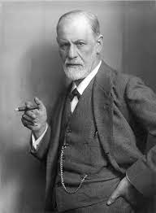
Psychoanalytic developmental theory
“We know, too, that to suppress the development of affect is the true aim of repression, and that its work does not terminate if this aim is not achieved”

Slide 31
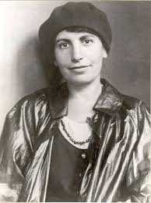
Psychoanalytic developmental theory
“…every individual has a limited number of defences at his disposal, and that he may use them against the drive or against the affect, but the defense against the affect is much easier to demonstrate to the patient.”
Anna Freud, The Analysis of Defence

Slide 32
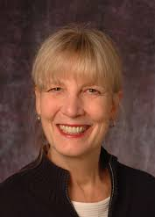
Psychoanalytic developmental theory
“The person using a defense is generally trying unconsciously to accomplish one or both of the following: (1) the avoidance or management of some powerful, threatening feeling, usually anxiety but sometimes overwhelming grief, shame, envy, and other disorganizing emotional experiences; and (2) the maintenance of self-esteem.”
Nancy McWilliams, Understanding Personality Structure in the Clinical Process: Psychoanalytic Diagnosis

Slide 33
Personality development and emotion
Neurotic
Borderline
Psychotic
OCP Narcissistic Masochistic Histrionic Schizoid Sadistic Psychopathic Depressive Avoidant Dependent…

Slide 34
Human nature
F.E. – Compulsive behaviours attempt to keep us alive by decreasing prediction error, and leaving us in select states which have kept us alive in the past.
A.N. – Compulsive behaviours attempt to keep us alive, by returning to homeostasis, thereby decreasing negative emotions/increasing positive emotions
Psychoanalytic theory – we develop compulsive personality patterns, which are ‘learnt’ mechanisms to avoid intolerable and painful feeling states

Slide 35
outline
Human Nature
Addictions
Treatment

Slide 36
What are addictions?
In the beginning
Olds and Wise
Then…
Further Scientific findings
Philosophical perspectives
Biological/Medical model
Learning theory
Developmental/Trauma
Myths of Addiction
NPSA model to unite them all…

Slide 37
In the beginning…
Olds & Milner were looking for the seat of emotions in the brain “such as love, fear, pain and pleasure?”
Asked “how is one to measure an animal’s feeling of pleasure?”
Answered by stating that B.F. Skinner “…worked out a technique for measuring the rewarding effect of a stimulus (or the degree of satisfaction) in terms of the frequency with which an animal would perform an act which led to the reward.”

Slide 38
In the beginning…
Olds & Milner’s experiments revealed evidence of ‘rewarding’ behaviours (Skinnerian) when electrodes were stimulated, that were placed in the mid-line structures of the brain
Self-stimulation
Place preference
2 years later, in an article published in Science, Olds concluded that
“The cells which mediate primary rewarding effects are located in a midline running from the midbrain through the hypothalamus and midline thalamus and into the subcortical and cortical groups of the rhinencephalon”.
Interestingly, he also concluded that
“it is reasonable to hope that eventually it will be possible to control the reward systems pharmacologically in cases where behaviour disorders seem to result from deficits or surfeits of positive motivation”.

Slide 39
In the beginning… Emotions disappeared
“Thus, in the present paper, the terms 'reward' and 'reinforcement' will be used interchangeably and treated as synonymous. Brain stimulation, drug injections and environmental stimuli will be said to be rewarding or reinforcing if animals will learn to perform acts which are regularly followed by such stimulation, injections or stimuli. Subjective states of pleasure or euphoria will not be implied by either term.”
Roy Wise 1978

Slide 40
And then…
Roy Wise reviewed the relationship between CAs and the rewarding pathways (1978)
“In the past decade and a half, thinking about reward systems in the brain has been greatly influenced by one form or another of the catecholamine (CA) hypothesis. In its simplest form, this hypothesis suggests that some 'reward neurons' contain a catecholamine as their neurotransmitter. More carefully stated, the position is that there exist one or more central neural systems which are specialized for, and which play a critical role in, reward phenomena, and that at least one critical link in the system systems is a set of CA-containing neurons.”
“The evidence suggests that there is a dopamine system in the brain that plays a critical role in the rewarding quality of brain stimulation and at least some other rewards. In this sense it can be concluded that dopamine plays a specialized role in reward processes. It is not necessarily the case that this dopamine system is specialized in the sense of having no other role in addition to this role in reward processes, and it is not necessarily the case that all rewards depend on this dopamine system for their rewarding impact. It does, however, seem to be the case that a dopaminergic system forms a critical link in the neural circuitry which confers rewarding qualities on intracranial stimulation (at least with a number of electrode placements) and on intravenous stimulant injections.”

Slide 41
It arrived…
Roy Wise - Addiction is about dopamine/reward
“Our current working hypothesis that the rewarding effects of these drugs summate with the rewarding effects of stimulation, increasing the rewarding consequences of self-stimulation by increasing the synaptic levels of nucleus accumbens dopamine that are known to be caused by each treatment by itself”
Self-Stimluation and Drug Reward Mechanisms
Annals New York Academy of Sciences 1992 654(1)
Wise et al.

Slide 42
What are addictions?
In the beginning
Olds and Wise
Then…
Further Scientific findings
Philosophical perspectives
Biological/Medical model
Learning theory
Developmental/Trauma
NPSA model to unite them all…

Slide 43
scientific neurobiological theories
Opponent processes theories
Dual processing theories
Incentive-salience theory

Slide 44
opponent processes
“…there must exist many systems in the brain, the business of which it is to suppress or reduce all excursions from hedonic neutrality, whether those excursions be appetitive or aversive, pleasant or unpleasant. The systems operate to decrease the intensity of subjective "hedonic quality," "affect," "emotion," "arousal," or the reinforcing properties of stimuli. The systems function independently of operants or instrumental acts: they are fully automatic. Thus, whereas operants tend to maximize positive reinforcement and to minimize negative reinforcement, these central nervous systems minimize both”.
Example
Dog electric-shock; terror
Dog cessation of shocks; stealth
Recurrent shocks; pained
Recurrent cessation; joy

Slide 45
States of ‘opponent processes’ are avoided
“We can describe opiate, alcohol, barbiturate, amphetamine, or cigarette addiction within the empirical framework we have proposed. It has these properties: (a) the B' state lasts a long time; (b) the B' state is intensely aversive; (c) the elicitation of State A or A' is effective in causing immediate removal of State B or B'; and (d) the user employs the opiate which elicits States A or A' in order to get rid of State B or State B'.

Slide 46
Current opponent process theories; koob
“Repeated withdrawal from drugs of abuse in humans in the withdrawal/negative affect stage is defined by the presence of both physical signs and motivational signs of withdrawal, such as chronic irritability, physical pain, emotional pain (i.e., hyperkatifeia…), malaise, dysphoria, alexithymia, sleep disturbances, and the loss of motivation for natural rewards. The hypothesis here is that allostatic changes in the stress axis, notably activation of the HPA axis, with subsequent blunting of the HPA axis and sensitization of extrahypothalamic CRF, are further exaggerated by repeated binge-withdrawal cycles of drug taking, such that progressively greater negative emotional states are generated that drive negative reinforcement.”

Slide 47
Dual processing theories
Cortical versus sub-cortical control.

Slide 48
Incentive salience (berridge)
3 stages to reward learning
Like something (pleasure) – dopamine not necessary or sufficient
Learn that I like it – dopamine not necessary or sufficient
Want it – dopamine is necessary for this stage only
Berridge states; “Dopamine drugs that activate mesolimbic systems short circuit normal physiological-learning interaction, by plugging directly into the neurobiological mechanism that ordinarily adjusts learned incentive salience in accordance with psysiological states. Drugs that activate dopamine neurotransmission or induce neural sensitization may thus directly elevate ‘wanting’ for rewards…”

Slide 49
Incentive salience - problem
According to the incentive-salience theory of reward-learning and addiction (and current scientific knowledge), dopamine is associated with ‘wanting’ or motivation for a reward, not the pleasure of the reward itself.
Drugs of addiction become addictive, in part, through stimulating dopamine.
However, if dopamine is triggered by addictive drugs, then according to the theory, it should not cause the ‘liking’ which is the first step of the learning/addiction process. The drug should not actually become addictive, because there is nothing pleasurable about taking it. Remember, dopamine is not seen as necessary or sufficient for the ‘liking’ or pleasure reactions, which are the first step of the addictive process.
As Panksepp, Solms and Pantelis note;
“Drug-induced surges in salience attribution should incentivize the addicts to pay extra attention to the pleasure-generating things they come across while high, not to the thing (the DA agonist) that merely induced the high . On Berridge’s own theory, the DA agonist is not intrinsically pleasure generating. The incentive-salience theory therefore erroneously treats the DA agonist as if it were itself the reward (the “liking”), which it is not”.
FEELINGS/EMOTIONS HAVE DISAPPEARED

Slide 50
Unanswered scientific questions about neural correlates of addictions
Role of DA
Roy Wise – drive and reward
Kent Berridge – dopamine correlates with ‘wanting’ (drive) not ‘liking’/pleasure
Role of other systems
David Nutt – it’s gotta be more than more than dopamine
e.g. opiate addiction
Meso-limbic dopamine also underlies aversive responses (not just rewarding ones)
Minimise/ignore impact of adverse childhood experiences/traumas

Slide 51
What are addictions?
In the beginning
Olds and Wise
Then…
Further Scientific findings
Philosophical perspectives
Biological/Medical model
Learning theory
Developmental/Trauma
Myths of Addiction
NPSA model to unite them all…

Slide 52
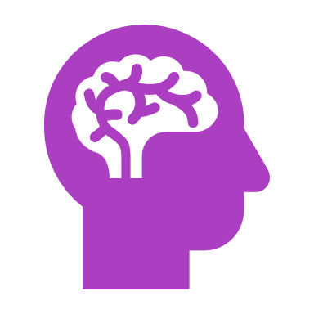
Philosophical perspectives
Philosophy of Mind
How are the mind (subjective experience) and brain (objective stuff) related?
What do brain findings mean?

Slide 53
The reductive physicalist model
“That addiction is tied to changes in brain structure and function is what makes it, fundamentally, a brain disease… understanding that addiction is, at its core, a consequence of fundamental changes in brain function means that a major goal of treatment must be either to reverse or to compensate for those brain changes”.

Slide 54
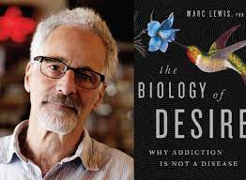
Learning theories
Addictions reflect natural (non-diseased) learning processes which are associated with dopamine circuitry.
A notable example is Marc Lewis; The Biology of Desire.

Slide 55
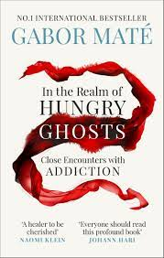
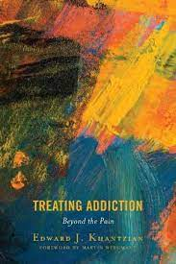
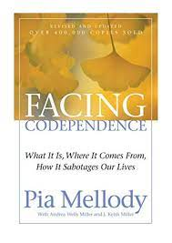
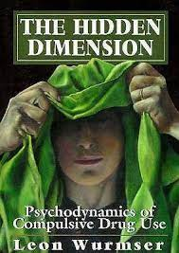
Developmental perspectives
Brain changes reflect neurodevelopmental, experientially associated alternations
Includes trauma, attachment and self-medication theories

Slide 56
What are addictions?
In the beginning
Olds and Wise
Then…
Further Scientific findings
Philosophical perspectives
Biological/Medical model
Learning theory
Developmental/Trauma
Myths of Addiction
NPSA model to unite them all…

Slide 57
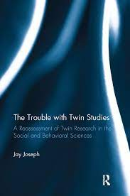
Myth busters
Addictions are inherited
“Heritable” not “inherited” (variation versus causation)
“heritability estimates do not estimate the relative weight of genetic and environmental influences in a population, and are misleading and potentially harmful when presented this way”
Always environmental aspects

Slide 58
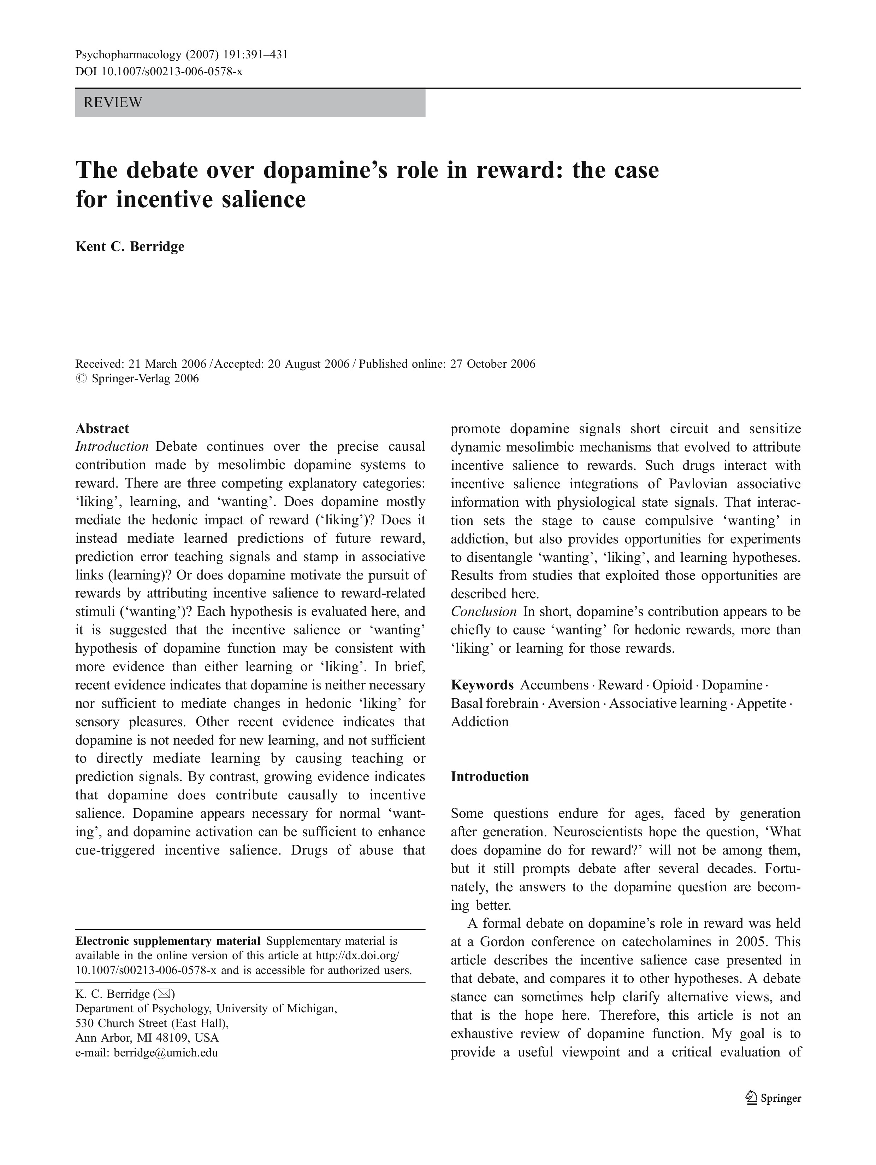
Myth busters
Addictions are about pleasure, and dopamine is the brain’s pleasure molecule
“In short, dopamine activation does not appear to cause the hedonic impact of reward. Finally, fairness requires acknowledging that Roy Wise, who chiefly originated the hedonia dopamine hypothesis, is on record, as subsequently changing his mind: “I no longer believe that the amount of pleasure felt is proportional to the amount of dopamine floating around in the brain,” he said in an interview published in the journal Science (Wickelgren 1997, p. 35).”

Slide 59
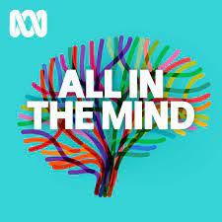
Myth busters
Thomas Szasz (1920 – 1970)
“…but behaviour is not a disease, it cannot be a disease, only the body can predicate disease”.
Behaviours have meaning (in a particular context), can’t be diseased

Slide 60
Myth busters
Psychiatric diagnoses represent valid disease entities.
What are psychiatric diagnoses?
Description versus explanation
Alternate models
Compulsions (internal and external)
Separation between head/heart – non-integration

Slide 61
What are addictions? A neuropsychoanalytic perspective
Causation
Conceptualisation

Slide 62
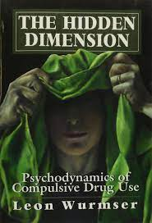
Causation - Freud & Wurmser
Preconditions
ACEs/Traumas resulting in emotional dysregulation (overwhelm or alexithymia)

Slide 63
Causation - freud & wurmser
Specific Causes
Emotional overwhelm
Too much or too little
Self-esteem/’Narcissistic’ injury
Shame (hiding) & Fear (avoiding/running)

Slide 64
Causation - freud & wurmser
Immediate Causes
Availability of drugs/behaviours

Slide 65
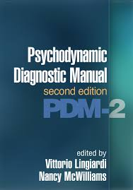
“The most prominent psychodynamic model of addiction interprets addiction as a form of self-medication against dysphoria or disordered mood… because an addiction serves a defensive function, it is very hard to stop. It ameliorates suffering, but because that relief is only temporary, the person needs to engage again in the defensive behaviour of addiction once the relief wears off… Psychoactive drugs help people who misuse substances to tolerate intolerable feelings…”

Slide 66
Conceptualisation of addiction
Need not met Need met
‘Bad’ feeling ‘Good’ feeling
Neural Correlates Neural Correlates

Slide 67
What are addictions?
Using the external world to deal with something internal which can’t otherwise be dealt with
A solution to a forgotten problem (implicit ‘memories’)
A (learnt) way to escape pain (Mate/Lewis)
An escape from a part of the self
Moving away from something (addicts) versus moving towards something (users)
An answer to trauma

Slide 68
outline
Human Nature
Addictions
Treatment

Slide 69
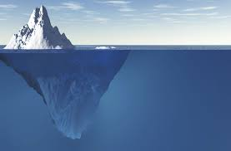
Addiction
Unresolved emotional difficulties based in earlier life experiences

Slide 70
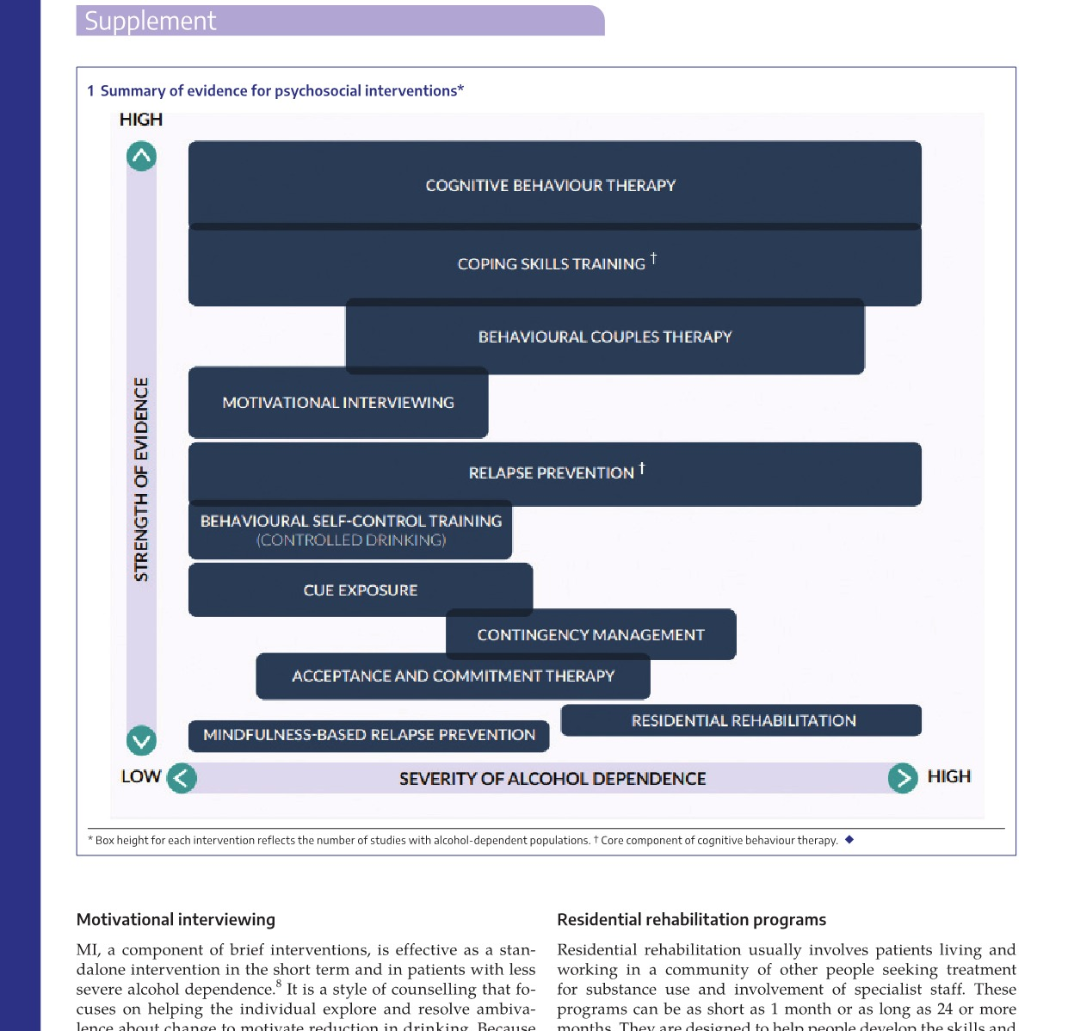
Current guidelines – mja 2021 supplement aud

Slide 71
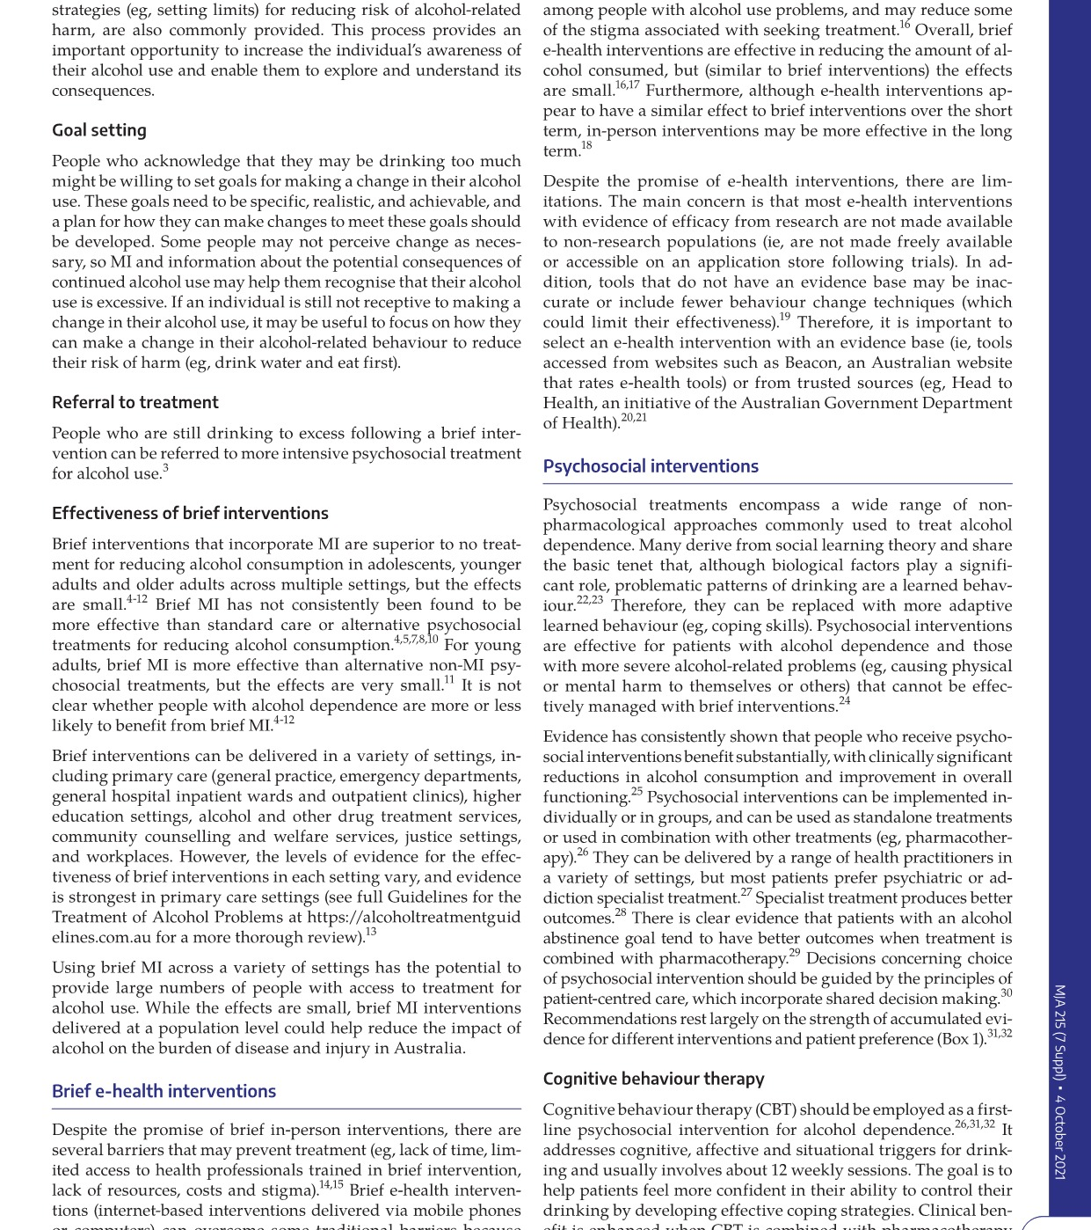
Current guidelines – mja 2021 supplement aud

Slide 72
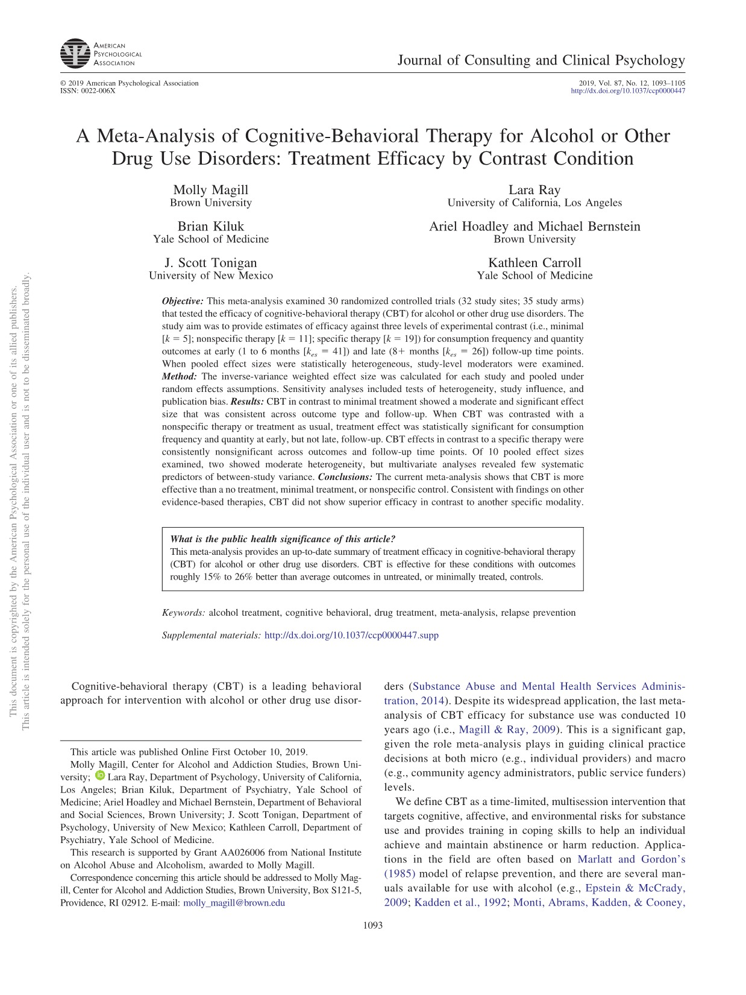
In contrast to minimal treatment
e.g. waitlist, assessment only
“Converting effect estimates to a percentile success rate the data show 15% to 26% of CBT participants had better outcomes than the median of those in minimal treatment conditions.”
In contrast to nonspecific therapy
e.g. supportive therapy
“The pooled effect size for frequency outcomes at early follow-up was small and statistically significant with a success rate roughly 8% higher than the median within the contrast condition. However, the effect was nonsignificant at late follow-up”
In contrast to a specific therapy
e.g. MI, contingency management
“The pooled effect size for frequency outcomes was nonsignificant at early and late follow-ups.”
Study populations don’t represent patients that I see, and are less severe

Slide 73
Treatment
Guiding principles
Integration
Personalised
Trans-diagnostic
Clinical Focus
Addiction
Trauma/ACEs
Personality patterns/vulnerabilities
Practical Points

Slide 74
Guiding principles
1. Integration
2. Personalised
3. Trans-diagnostic

Slide 75
Guiding principles - integration
Integration = healing = connecting head and heart = self-awareness
To turn around and face oneself, rather than avoiding aspects of the self
This is confronting, anxiety provoking, painful (for both patient and therapist)
Our system of diagnosis and treatment in many ways is set up for the opposite of integration
Symptom control versus integration
e.g. 5HT1A versus 5HT2A receptors

Slide 76
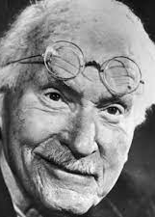
GUIDING PRINCPLES - PERSONALISED
“Judged scientifically, the individual is nothing but a unit which repeats itself ad infinatum and could just as well be designated with a letter of the alphabet. For understanding, on the other hand, it is just the unique individual human being who, when stripped of all those conformities and regularities so dear to the heart of the scientist, is the supreme and only real object of investigation. The doctor, above all, should be aware of this contradiction. On the one hand, he is equipped with the statistical truths of his scientific training, and on the other, he is faced with the task of treating a sick person who, especially in the case of psychic suffering, requires individual understanding. The more schematic the treatment is, the more resistances it – quite rightly – calls up in the patient, and the more the cure is jeopardized. The psychotherapist sees himself compelled, willy-nilly, to regard the individuality of a patient as an essential fact in the picture and to arrange his methods of treatment accordingly. “
Jung, The Undiscovered Self

Slide 77
Guiding principles - transdiagnostic
Trend to become super-specialized in mental health and addiction treatment
Suggests that diagnostic categories are valid categories, rather than reliable categories that may represent underlying issues
Different addictions may require alterations in the treatment of the specific addiction, however the same applies for;
Trauma/ACEs/OEEs
Personality vulnerabilities/patterns

Slide 78
Clinical focus
Addiction
Trauma/ACEs/OEEs
Personality Vulnerabilities/Patterns

Slide 79
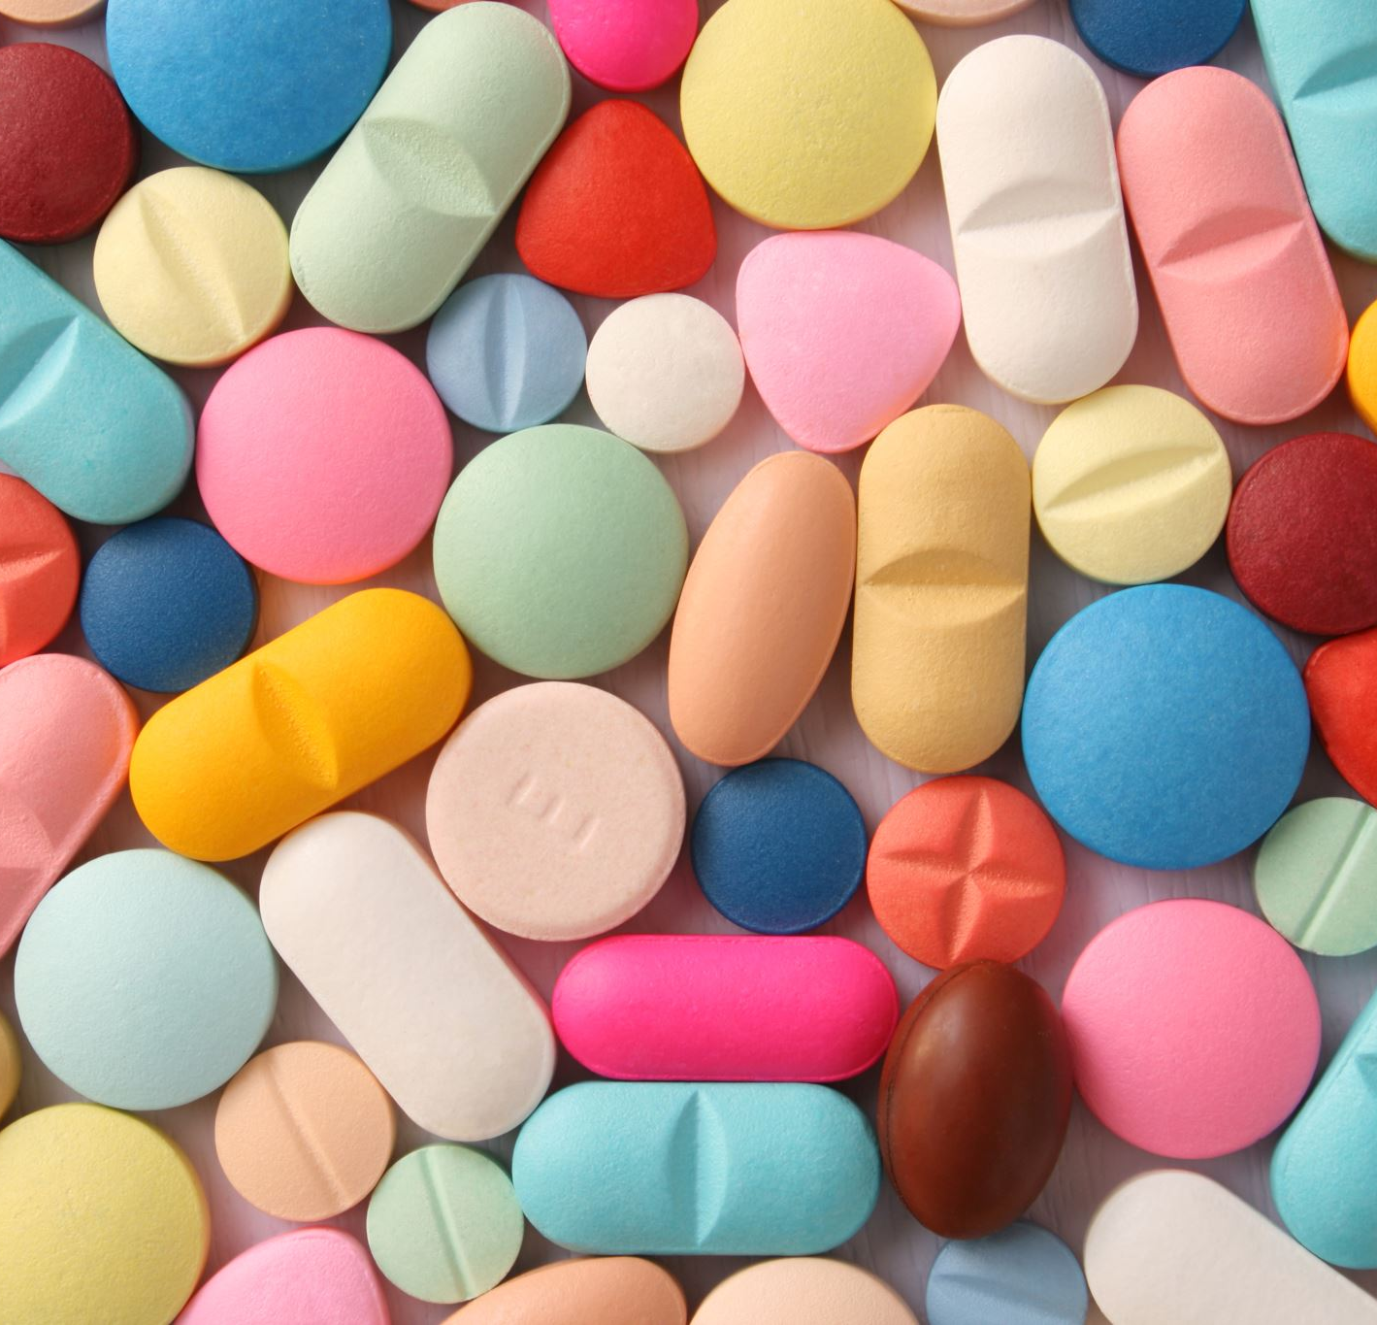
Practical points Integration In hospital setting
No sleeping tablets
Minimise medications
No PRN/’as required’ medications
Lots of psychoeducation
Creation of a safe container (lots of work!)

Slide 80
People need to be triggered
In a safe container
To begin to be reflective in the ‘here and now’
To begin to trust themselves
To begin to trust others
The greatest opportunity for growth

Slide 81
Process of integration join head and heart self-awareness
Awareness
Thoughts, images, feelings, body
Acceptance
The ‘shadow’ – thoughts/images
Feelings
Ownership
Not “your fault” or “my fault”
Triggers as rationalisations
Trigger versus cause
Understanding
Emotions are key
Need an emotional awareness to understand the triggers of patterns
Need an ‘emotional understanding’ of self

Slide 82
Practical points
Assume there is unresolved emotional pain
Assume the person is unaware (to some degree) of the emotional pain
Assume there will be resistance from the person’s mind-brain-body to find the emotional pain
The unresolved emotional pain will create unhealthy patterns, only one of which is the presenting complaint of the addiction
Two pieces of information
Historical
The here-and-now/transference-countertransference/relationship between me and the person

Slide 83
Relationship to the patient
“…the first prerequisite for successful psychotherapy is the respect that the psychiatrist must extend to the mental patient. Such respect can be valid only if the psychiatrist realizes that his patient’s difficulties in living are not too different from his own. This statement is not just a humanitarian or charitable hypothesis but a scientific conviction.”
Frieda Fromm-Reichman, Principles of Intensive Psychotherapy
“As adults we don’t need unconditional love, not even from our therapists. This is a childhood need, one that can never be fulfilled later in life, and we are playing with an illusion if we have never mourned this lost opportunity. But there are other things we can get from good therapists: reliability, honesty, respect, trust, empathy, understanding, and an ability to clarify their emotions so that they need not bother us with them. If a therapist promises unconditional love, we must protect ourselves from him, from his hypocrisy and lack of awareness”.
Alice Miller, The Drama of the Gifted Child

Slide 84
Resistance in therapy
“One other type of security operation which plays a great role in the patients’ dealings with psychotherapy and psychiatrists is the dynamic process know as ‘Resistance’. ‘Resistance’ means the reactivation, outside of the patients’ awareness, of the motivating powers which were responsible for the mental patient’s original pathogenic dissociative and repressive processes. This resistance manifests itself in the course of the psychotherapeutic process as a reluctance against relevant communication and against the acceptance of interpretive clarifications or its possible concomitant therapeutic changes. The same source which motivated the patient’s original dissociative and repressive processes, that is, his anxiety, is also the main reason for this resistance…Resistance is as much a process outside the patient’s awareness as the original dissociating processes are. It is up to the psychiatrist to be constantly alert to its recognition as it arises. The interpretation of processes of resistance should constantly be included in the psychiatrists’s and the patient’s collaborative efforts…”
Frieda Fromm-Reichmann, Principles of Intensive Psychotherapy

Slide 85
Initial Assessment - aims
Find the emotional pain
Help change the person’s understanding of themselves
Help them see they are deeper and more complicated than they think they are
Help change the person’s understanding of their addiction
From a pattern of behaviour
To a method to deal with emotional pain
As a solution to an underlying problem

Slide 86
Ongoing therapy relapse prevention connect Personality/behaviour to past experience
In many respects, people don’t relapse because they have an addiction, they relapse because of unhealthy patterns which inevitably draw them back to an emotionally overwhelming place. These compulsive patterns are learnt (old), compulsive because they are driven by emotional complexes.
“…a child can experience her feelings only when there is somebody there who accepts her fully, understands her, and supports her. If that person is missing, if the child must risk losing the mother’s love or the love of her substitute in order to feel, then she will repress her emotions… she will fail to experience them at all. But they will nevertheless stay in her body, in her cells, stored up as information that can be triggered by a later event. Throughout their later life, these people will have to deal with situations in which these rudimentary feelings may awaken, but without the original connection ever becoming clear. The connection can be deciphered only when the intense emotions have been experienced in therapy and successfully linked with their original situation”. Alice Miller
These emotionally driven behaviour patterns will be hidden behind a thought (the rationalization), usually justified by self-righteousness or self-loathing.

Slide 87
Thanks!
drelikotler@gmail.com

