Slide 1
Canberra Alliance for Harm Minimisation & Advocacy
CAHMA and The Connection
CAHMA PROJECTS
By
Natasha Nikolic and Chris Gough

Slide 2
CAHMA APPROACHES:
CAHMA VISION
CAHMA exists to promote the health and human rights of people who use, or have used, (illicit) drugs.
We believe that people who use drugs should be treated with dignity and respect, both as human beings and as consumers of health and social services.
CAHMA works to reduce the discrimination and stigma experienced by people who use drugs.
We also try to instill a sense of worth and pride in people who use illicit drugs.
Peer based AOD services
Harm Minimisation/Harm Reduction
Person-Centered
Human Rights (Support Don’t Punish)
Empowerment/Community Development
Consumers rights advocacy
Education /Information /Training
Australian Commission on Safety and Quality in Health Care (2011), Patientcentred
care: Improving quality and safety through partnerships with patients and consumers,
ACSQHC, Sydney.
This discussion paper is available on the Commission’s website:
www.safetyandquality.gov.au

Slide 3
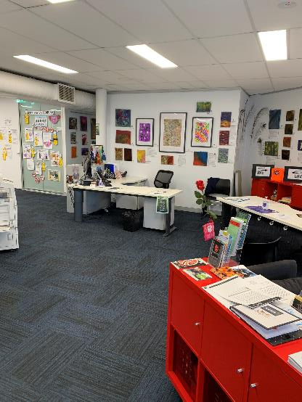
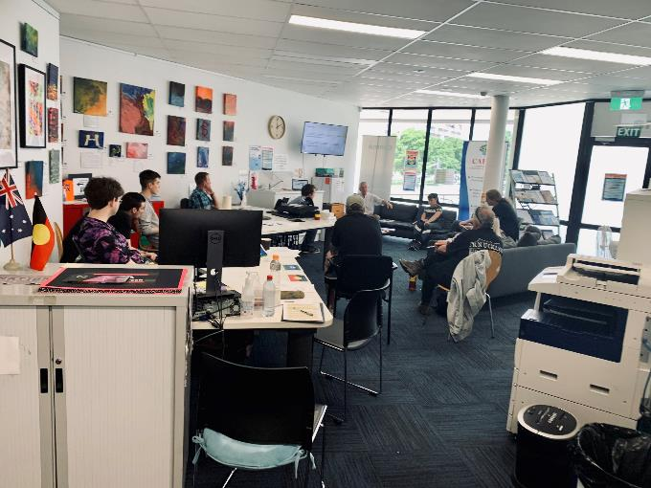
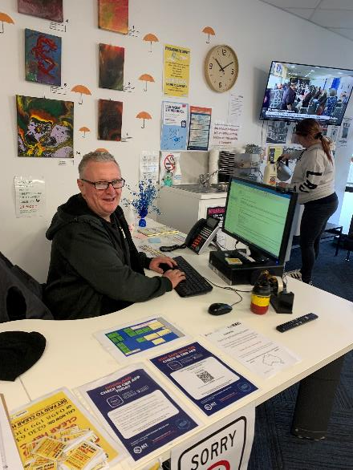
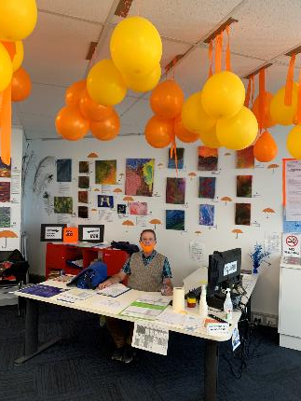
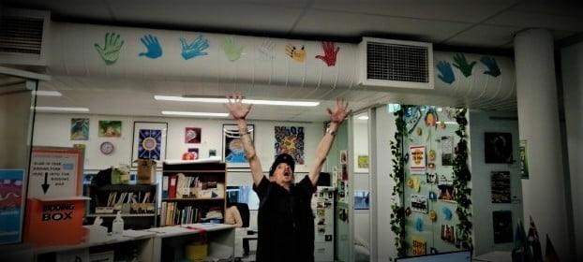
CAHMA Community Centre

Slide 4
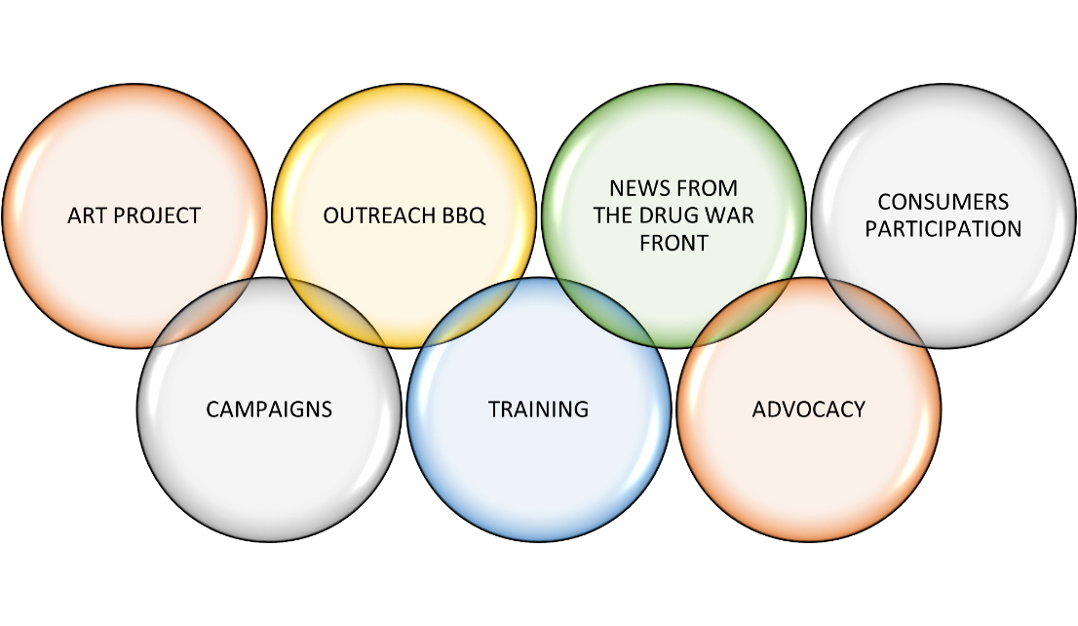
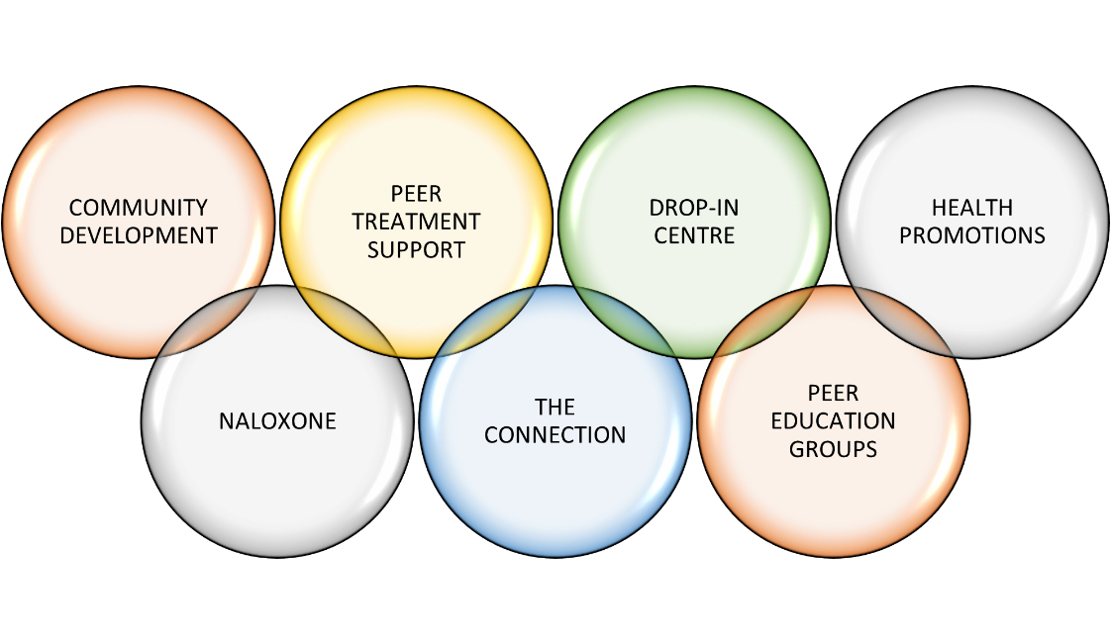
CAHMA PROJECTS

Slide 5
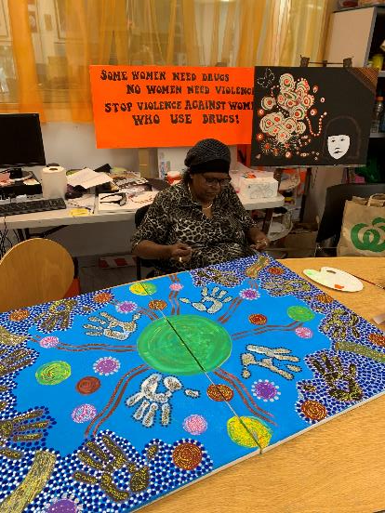
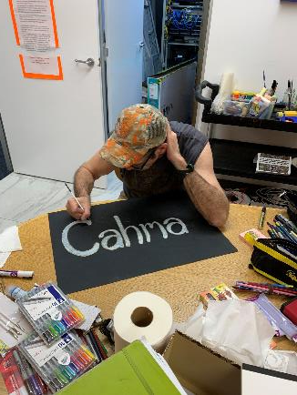
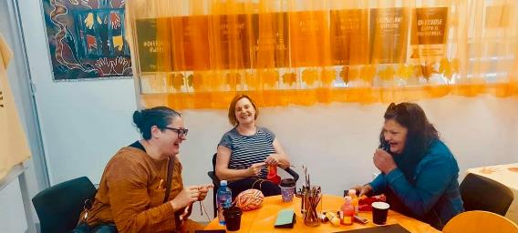
DROP-IN CENTRE
Providing essential services for visitors
Building social capital and service linkage
Referrals, brief interventions, PTS
Information/Education /Training

Slide 6
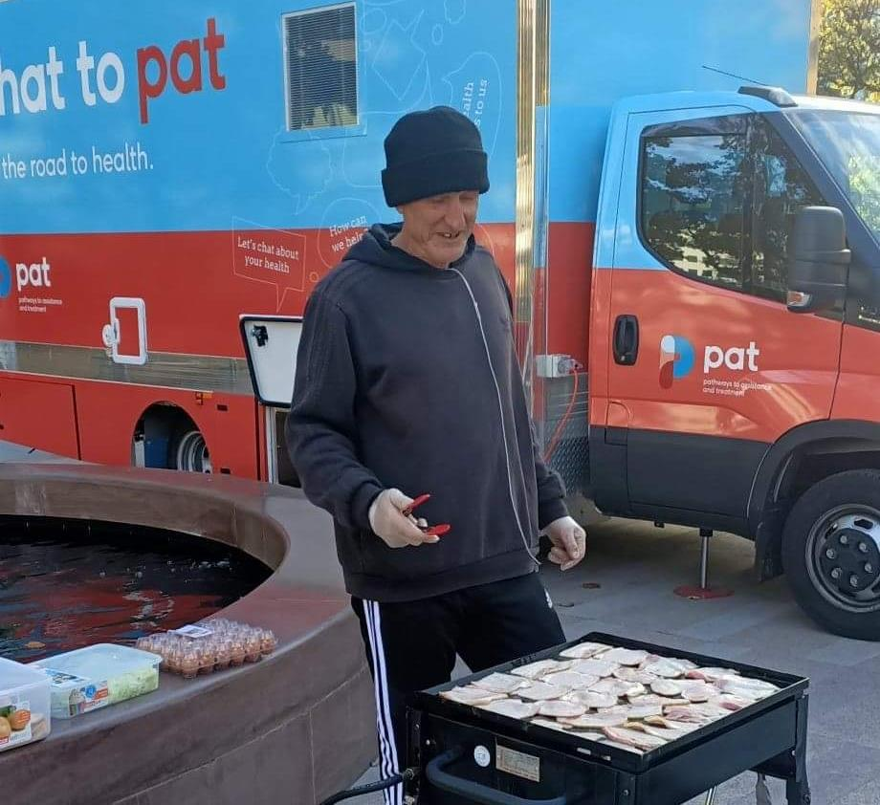
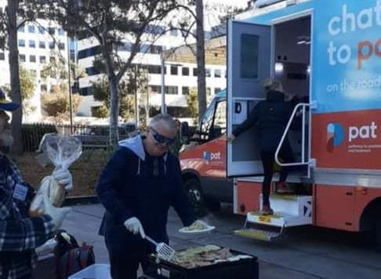
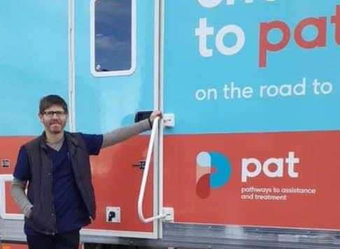
Outreach BBQ
Monday – Hawker
Wednesday – Oaks Estate
Thursday – Ainslie Village
Friday – Veteran’s Park

Slide 7
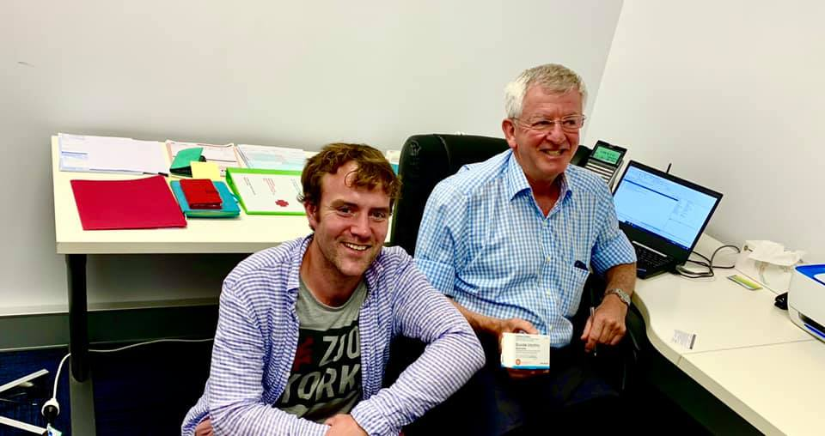
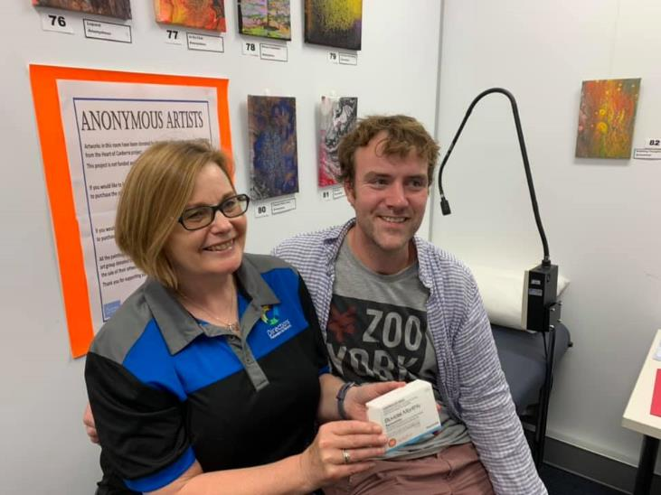
Doctor and nurse every Thursday Sexual Health Checks Opioid Maintenance Treatment Hepatitis C testing and treatment POCT HCV Wound dressing Veinoscope
CAHMA CLINIC

Slide 8
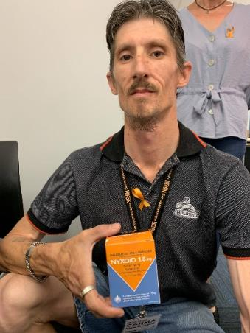
Naloxone
Brief Interventions (286 PEOPLE):
(@Drop-in centre and Outreach/BBQ) (69 people)
Through NSPs (217 people)
Peer group trainings (122 people):
Wednesdays at EMC
Toora Women’s groups (in-reach to residential clients)
Samaritan House
Oaks Estate
Karralika
Training professionals in the sector (151 staff):
University of Canberra Nursing Society (100 nurses across 3 groups)
Catholic Care (18)
St Vincent De Paul (9)
ATODA workers group (5)
Karralika (18 staff across 2 groups)
Directions NSP and HR workers

Slide 9
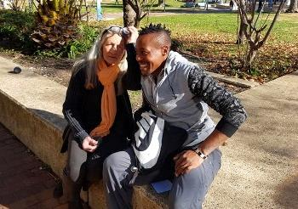
PEER TREATMENT SUPPORT

Slide 10
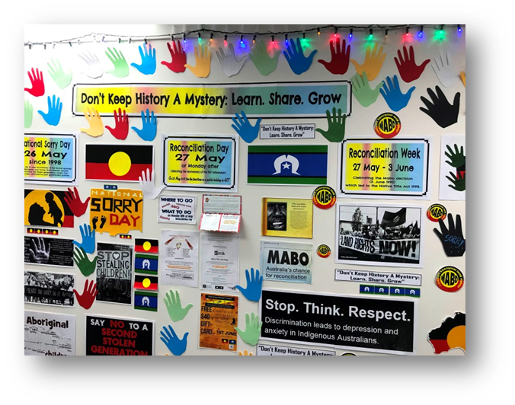
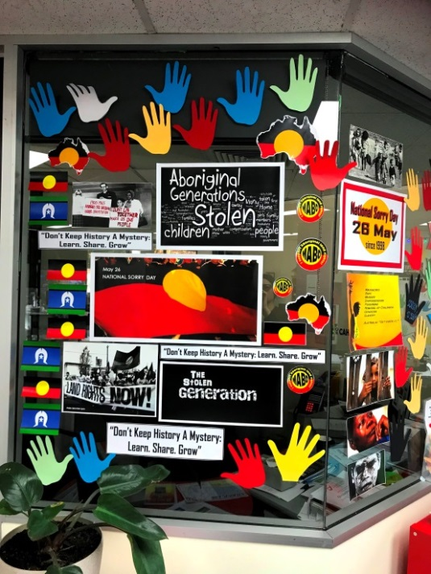
THE CONNECTION
CAHMA’s Aboriginal and Torres Strait Islander peer service

Slide 11
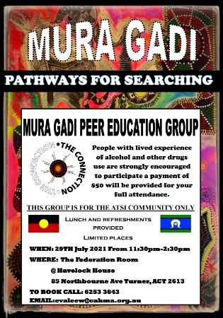
PEER EDUCATION GROUPS
Aboriginal peer education group
Women’s support group
People who use drugs and COVID-19
Hepatitis C peer support group

Slide 12
ANU
Lazaretto
Ainslie Village
COVID-19
CAHMA PEER SUPPORT -
- ESSENTIAL WORKERS
Condamine Court
Ragusa
Community

Slide 13
LEVEL 2
COMMUNITY DEVELOPMENT PROJECT
LEVEL 4
LONG TERM EMPLOYMENT
LEVEL 3
CAHMA and ATOD Services
CASUAL WORK
BBQ Outreach Brief interventions, Project work, Consumer participation and Systemic advocacy
VOLUNTEERING
Front of house:
computer skills, admin role, emails, reception, phone, language
First point of contact with clients
LEVEL 1
TRAINING
Module 1
CAHMA policies and procedures
Module 2
Practical tasks
Module 3
Harm reduction (history, theoretical framework, peer education, person centered care,
Module 4
CAHMA projects
CAHMA model of care
Module 5
CAHMA partnerships

Slide 14
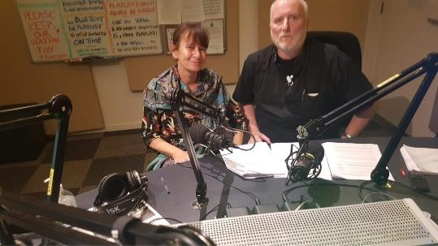
News from the Drug War Front
Every Tuesday
On Community Radio 2xx
98.3 fm
From
10.30am -12 pm

Slide 15
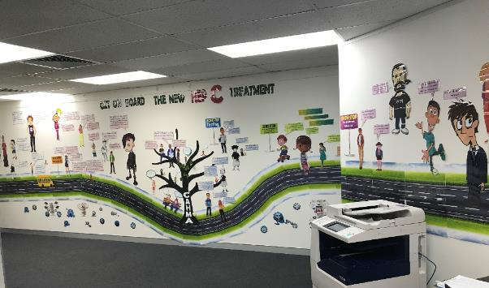
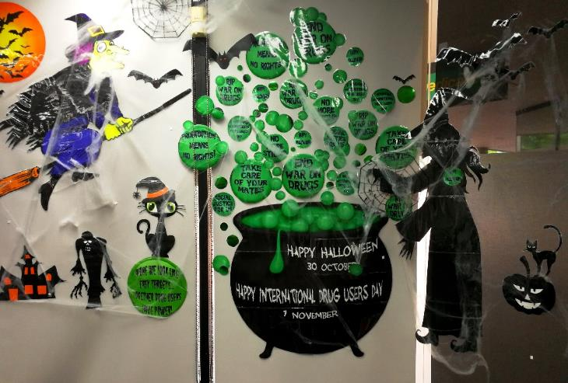
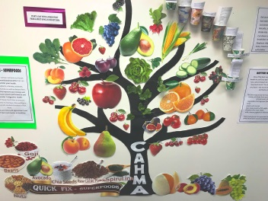
HEALTH PROMOTIONS

Slide 16
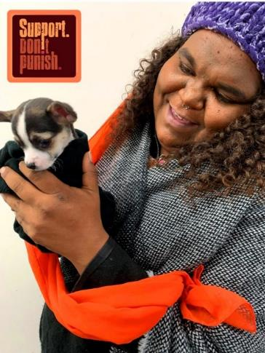
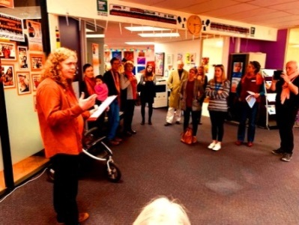
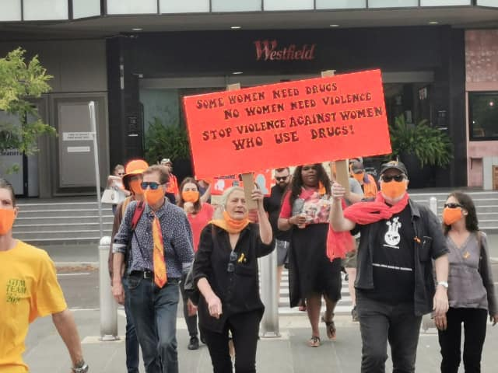
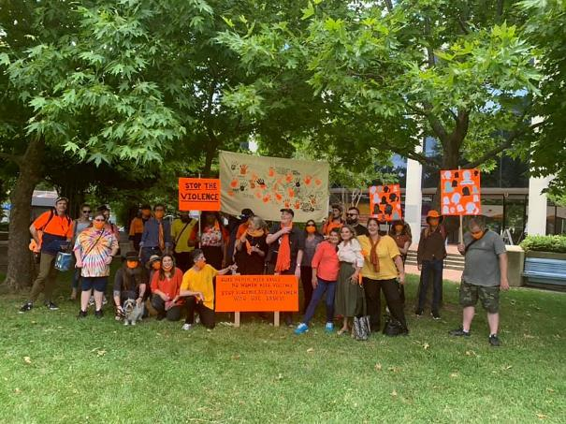
Campaigns

Slide 17
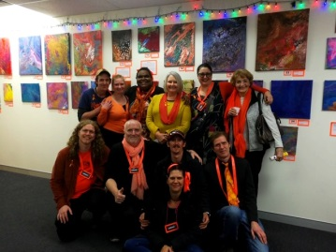
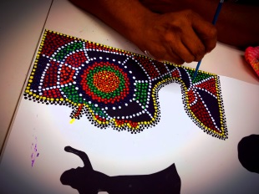
ART PROJECT
NOTS ATODA NADA AIVL IHC NDARC
Hepatitis Australia Hepatitis ACT
http://artfromtheheartofcanberra.com.au/paint-it-orange/

Slide 18
PEER TREATMENT SUPPORT -Model

Slide 19
Our approach
What does the support look like?
Trusting
Relationship
Support
Coordination
Support as
Needed
Identify Needs
Build Capacity
Establishing a trusting relationship is Integral. Our Peer Workers have a range of skills and experience that help them engage with a broad population. We have expertise working with people who use substances and understand the stigma, barriers and impacts affecting them.
People may approach our service for a range of different reasons. Our Peer Workers work closely with the person to explore their current needs and what options are available. These may be immediate needs or long-term goals.
Our Peer Workers provide ongoing weekly - fortnightly meetings to coordinate support across multiple risk factors. We help support the person to maintain relationships, accomplish tasks, manage challenges and ensure consistent delivery of service.
The program aims to increase the persons capacity to meet their needs and overcome barriers in an effective and sustainable way. This includes building appropriate supports, skills, knowledge and independence.
Our Peer Workers provide ongoing support as needed after the treatment goals have been achieved and the person is demonstrating reduced hardship or greater ability to respond to life situations themselves.. We can step back until support is again.
ENGAGEMENT ZONE

Slide 20
Principles of Support Coordination
The following principles underpin CAHMA’s approach to Support Coordination
: :
Principles of Peer Treatment Support
What principles underpin our practice?
Inherent Worth and Dignity of all
The recognition that each individual is unique with inherent worth and dignity is a fundamental principle underpinning CAHMA’s interactions with service users and the community.
Client Oriented
Support Coordination will focus on the service user’s needs and goals and develop customised strategies to assist each individual to achieve their stated goals.
Self-Determination
CAHMA is committed to empowering our service users in the pursuit and achievement of their goals. We promote the self-determination and autonomy of service users, actively seeking to enable them to make informed decisions on their own behalf. This includes working to reduce barriers to self-determination for those who are unable to act for themselves, due to factors such as vulnerability, disability, age, dependence, language, religion and/or culture.
Strengths-Based Approach
A philosophy for working with individuals, families and communities that recognises the resilience of service users and focuses on their strengths, interests, abilities, knowledge and capacities, rather than their problems as with traditional deficit models.
Systems Approach
CAHMA recognises that a person's behaviour and capacity to achieve their goals is inextricably linked to their social, economic and environmental surroundings. CAHMA is committed to providing services that are holistic and responsive to the broader context of our service users' lives
Respect for Privacy
CAHMA is committed to ensuring that the information shared with us by our service users is treated with the utmost respect. Maintaining service users' rights to privacy and confidentiality is the highest priority.

Slide 21
Access Point
How do people enter our service?
Walk In
Phone Contact
Any person requiring support, whether it be practical or emotional is encouraged to walk through the door and talk to our team of peer workers.
Many community members may access support from our of peer workers over the phone for a variety of support. This minimizes many of the psychosocial barriers when engaging services.
Written Referral
CAHMA Services
People may be encouraged by another service to seek support from our team of peer workers independently or in parallel with theirs. The staff are encouraged to write a written referral which we will follow-up.
Many people seeking support first come our service through the many outreach services where a staff member or volunteer may encourage them to contact our team. This includes residential rehabs, community services, and targeted communities.

Slide 22
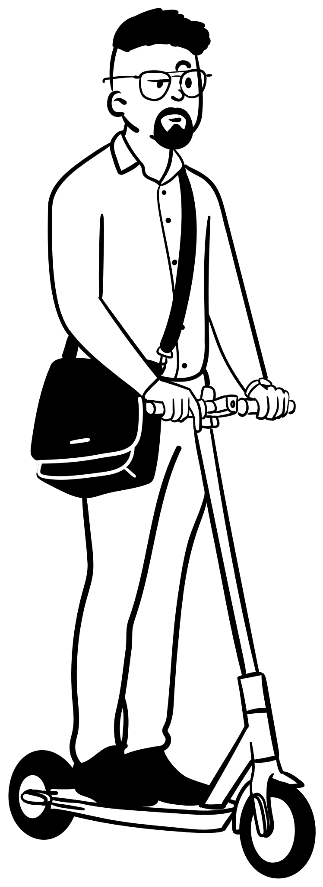
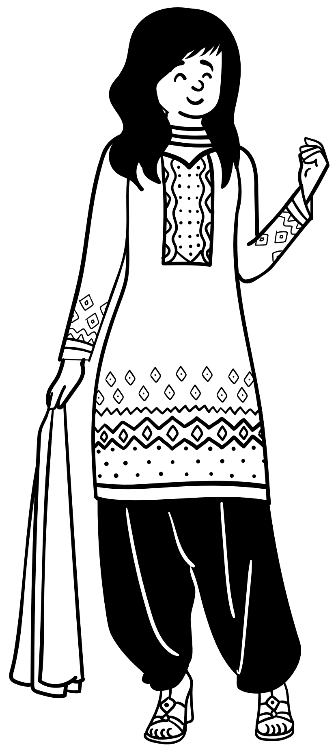
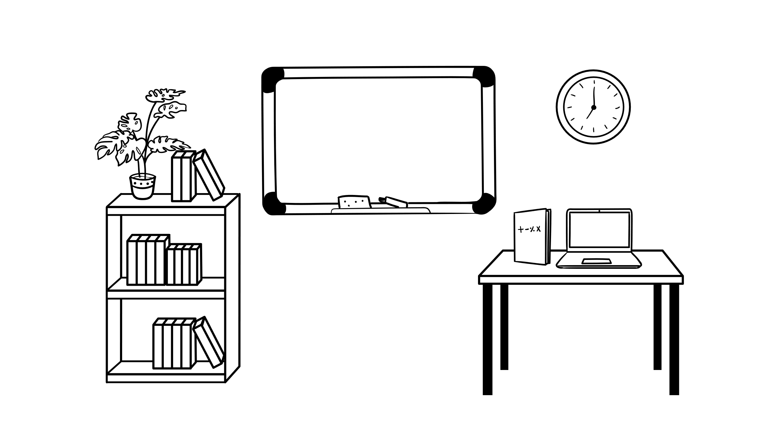
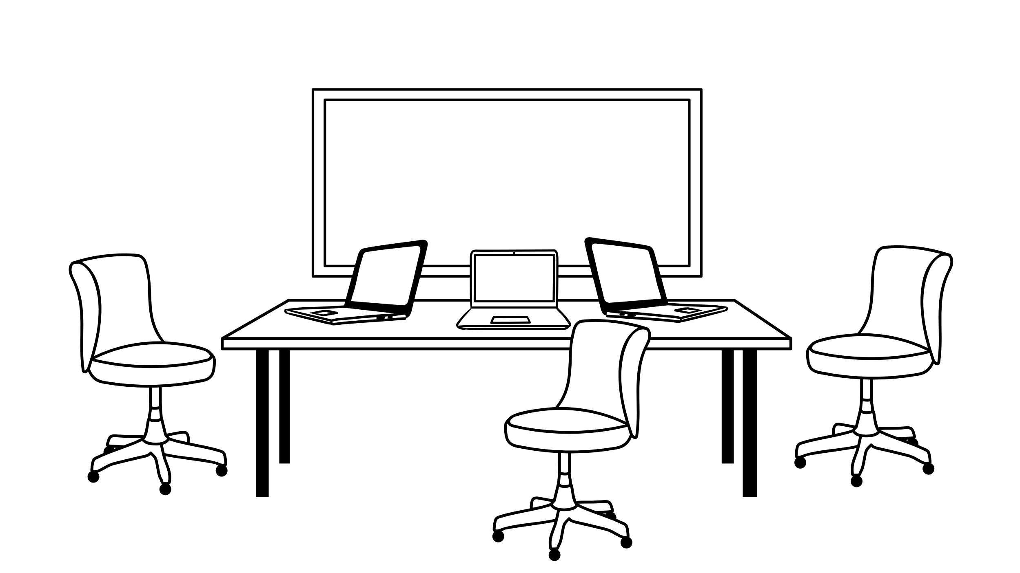
LEVEL 1 – DROP IN SUPPORT
LEVEL 1 – DROP IN SUPPORT
One area of support needed.
Person attends as needed.
Support completed within one encounter
Information, referral or practical support.
No commitment required.
Follow-up may be necessary.
LEVEL 2 – ONGOING SUPPORT
LEVEL 2 – ONGOING SUPPORT
One or multiple areas of support needed.
Person attends for scheduled weekly-fortnightly appointments.
Support completed over several encounters.
Client intake and assessment completed at initial meeting.
Case plan formulated and commitment sought. Reassess after 3 months.
Information, referral or practical support.
Assertive follow-up necessary.
LEVEL 3 – INTENSIVE SUPPORT
LEVEL 3 – INTENSIVE SUPPORT
Multiple areas or urgent support needed.
Person attends for scheduled daily-weekly appointments.
Supplemented with additional resources if needed.
Support completed over several encounters with idea to reduce frequency.
Client intake and assessment completed within first few encounters.
Case plan formulated and commitment sought. Reassess weekly.
Information, referral, practical, emotional support and advocacy
Assertive follow-up necessary.

Slide 23
Support Coordination
Tasks
Discuss case notes, limits to confidentiality, and rights and responsibilities.
What makes up the client file?
Initiate a case plan and complete an assessment
Complete any risks assessments that may be necessary. This could include mental health, suicidality, domestic and family violence, or child abuse or neglect.
Working with up to 15 people at a time with a variety of support needs.
Obtain a signed and dated consent to exchange information form. Include any relevant stakeholders and the purpose of any exchange in information.
Establish a Peer Treatment Support Client File using Redicase. Identify the primary worker and upload documents.
Complete file notes after meeting with person or completing background work.
Staff will initiate 3 attempts to contact the person via phone inviting a return call. The initial phone call should occur within 24 hours. Referrer to be notified of action.
If the person does not turn up for their meetings, and reasonable attempts were made to contact the person; then the person’s file may be closed, with the understanding that they cam re-engage in the future.

Slide 24
Peer Treatment Support
Support coordinating detoxification and residential rehabilitation journeys
Building treatment plans tailored to the individual
Support with legal and court and CYPS issues
Support to transition to release for prisoners
Support attending doctors appointments and accessing OMT programs
Support with housing and other social determinants of health

Slide 25
Integrated Care
How does PTS support integrated care approaches?
Provides clients and professionals with information as healthcare system is navigated.
Promotes communication between professionals
Enhances treatment matching
Encourages interdisciplinary approaches and co-ordination
Transportation
Fee payment
Systemic barrier removal

Slide 26
Continuity of Care
How does PTS support continuity of care?
Support clients to remain engaged with healthcare providers especially through complex or frustrating situations
Provides referral pathways and discuss healthcare options
Provide advocacy pathways so clients feel understood
Provide alternative ATOD providers if client is feeling isolated

Slide 27
Challenges for Peer Organisations
As described in various literature….
Clinicalisation of role
Program Funding
Role clarity
Workload – specifically for part time
Health & stress
Training, Supervision and mentoring
Relapse, Triggers and burnout stress
Disclosing personal Information
Boundaries – Peer vs Professional
Financial Compensation
Criminal records
Recruitment
Staff leave

Slide 28
THANK YOU
CAHMA and The Connection
https://www.facebook.com/CAHMAandTheConnection/
Located in: Churches Centre
Level 1, Belconnen Churches Centre
17/54 Benjamin Way, Belconnen ACT 2617
Phone:(02) 6253 3643
cahma.org.au
info@cahma.org.au

