Slide 1
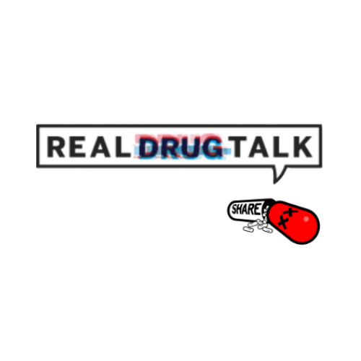





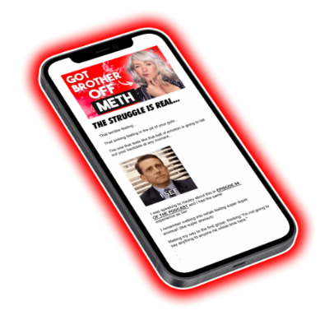

Shameless Digital Promotion
@realdrugtalk
www.realdrugtalk.com.au
@realdrugtalk
@jacknagle
Real Drug Talk on any podcast service
@realdrugtalk
@realdrugtalk
Join the newsletter

Slide 2
Stigma, The Hidden Cancer in
The AOD & Addiction Space

Slide 3


How Much Is
Too Much?

Slide 4
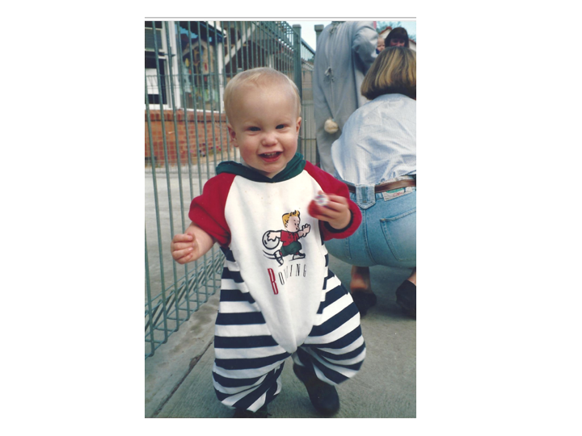

Slide 5
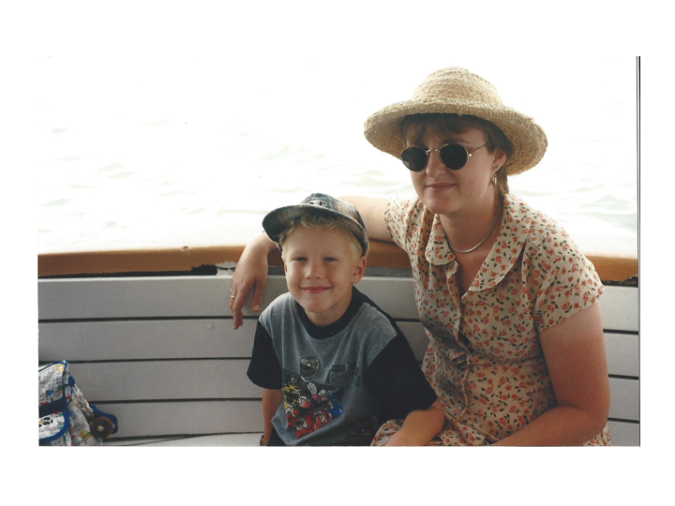

Slide 6
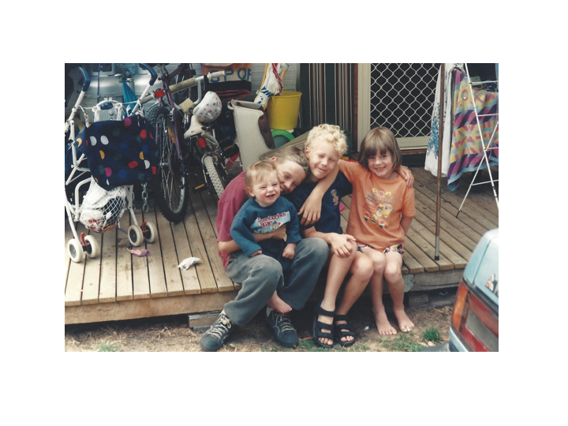

Slide 7


Slide 8
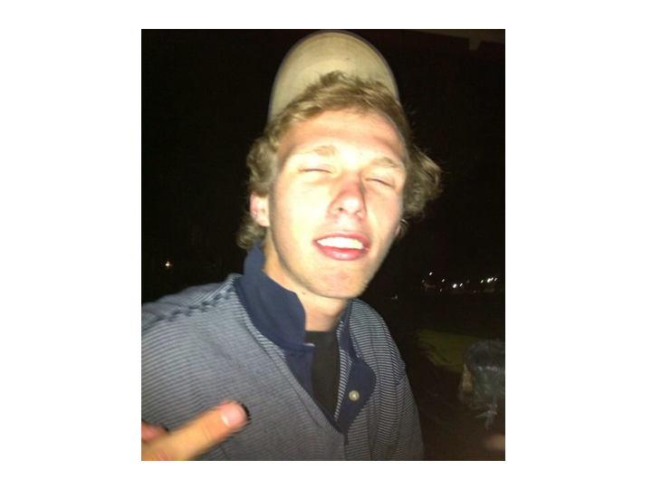

Slide 9
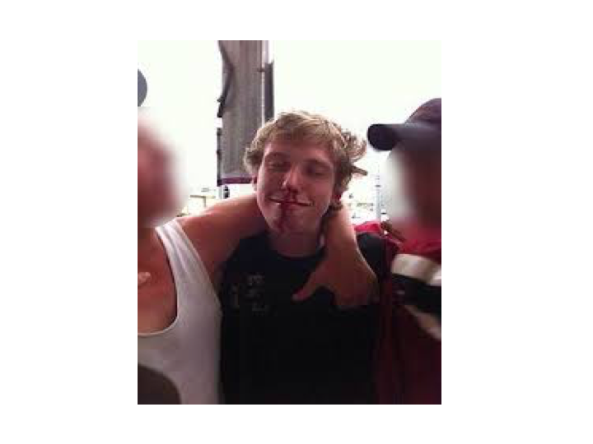

Slide 10


Slide 11



Slide 12
What Is Stigma?
Stigma is labelling and stereotyping of difference, at both an individual and structural societal level, that leads to status loss (including exclusion, rejection and discrimination). Discrimination is the lived effects of stigma – the negative material and social outcomes that arise from experiences of stigma. Both stigma and discrimination rely on societal structures and systems that facilitate and create the conditions for their operation (for example unequal power is one such condition).
Reducing stigma and discrimination for people experiencing problematic alcohol and other drug use A report for the Queensland Mental Health Commission

Slide 13
Let’s Talk About Self Stigma

Slide 14



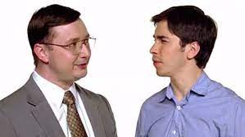

Slide 15


Slide 16
I have an addictive personality, but do I really?

Slide 17



Slide 18
Can We Change The Narrative - This Is Our Fault

Slide 19
Structural Stigma

Slide 20

Is That Nancy
Reagan?

Slide 21


Sorry That’s
Nancy Reagan

Slide 23
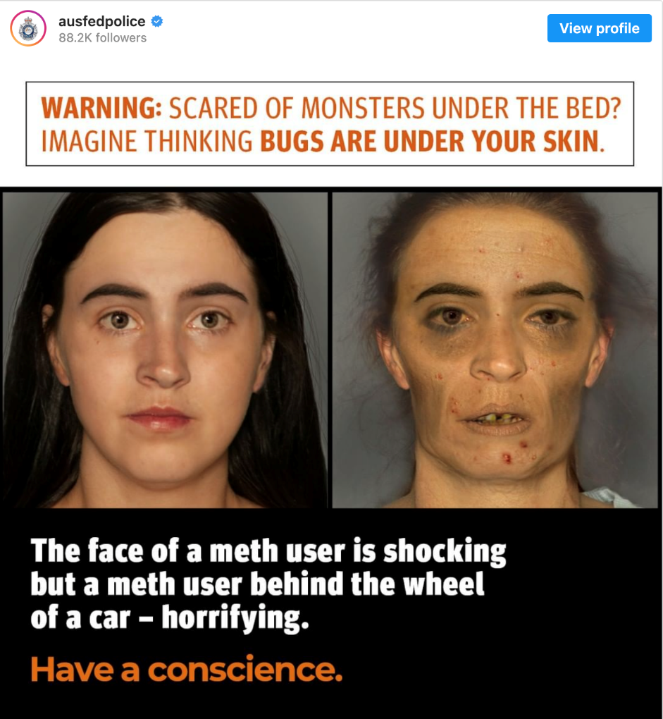
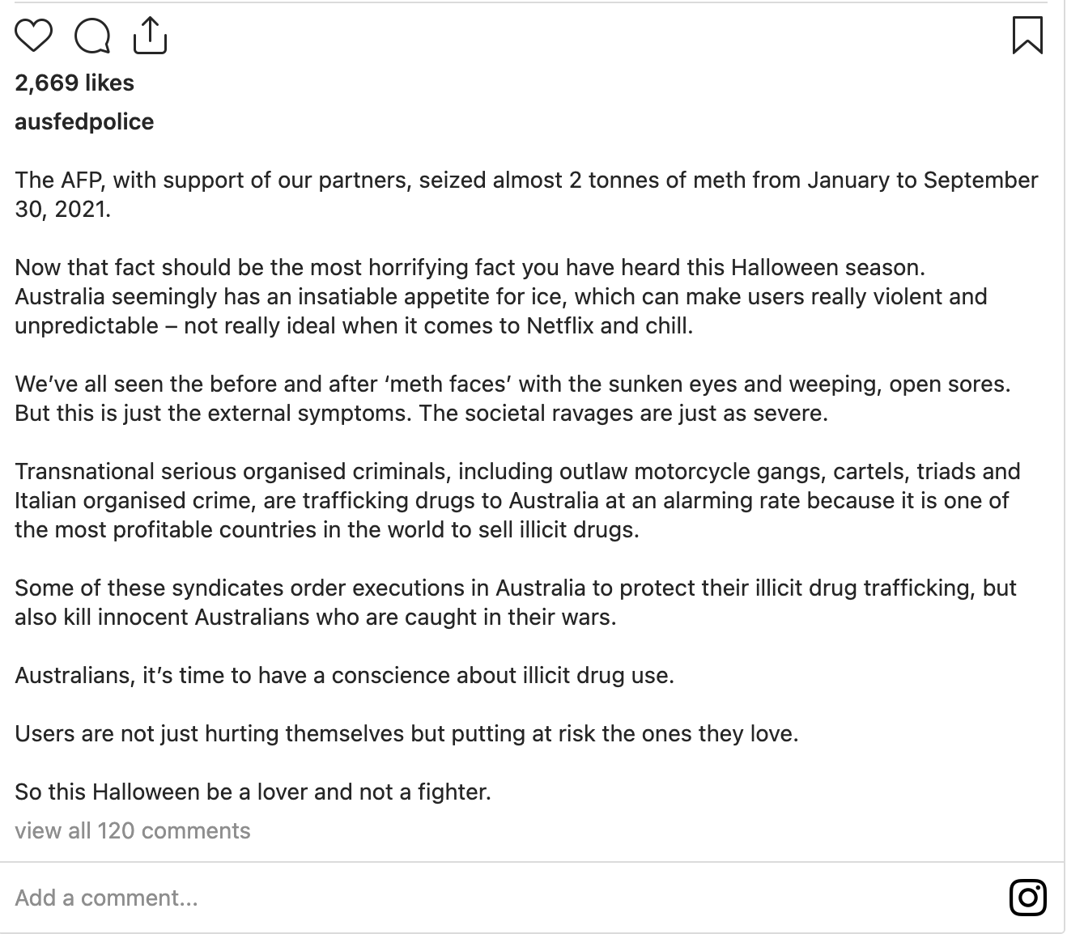
When In Doubt Get Your Drug Information From The AFP

Slide 24
Stop being negative…
Solutions Time!

Slide 25
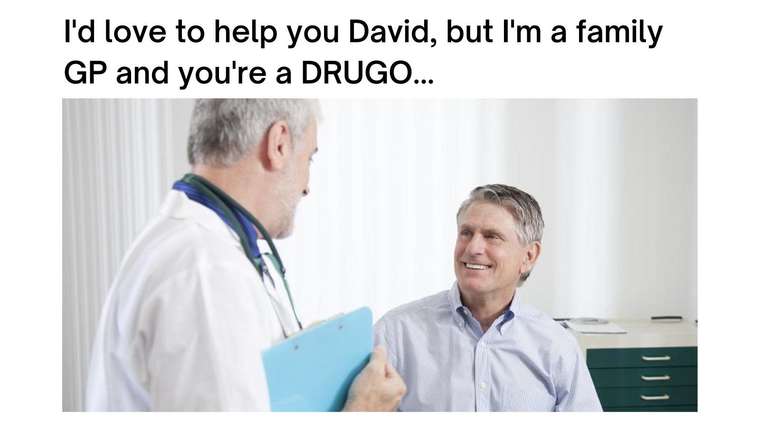
The Primary Health Head Scratcher…

Slide 26

Money Talks…What’s The Finacial Case

Slide 27
Uncomfortable Conversations

Slide 28
Shameless Digital Promotion
@realdrugtalk
www.realdrugtalk.com.au
@realdrugtalk
@jacknagle
Real Drug Talk on any podcast service
@realdrugtalk
@realdrugtalk
Join the newsletter

